Slide 1
PROJECTION OF SOLIDS
UNIT-IV

Slide 2
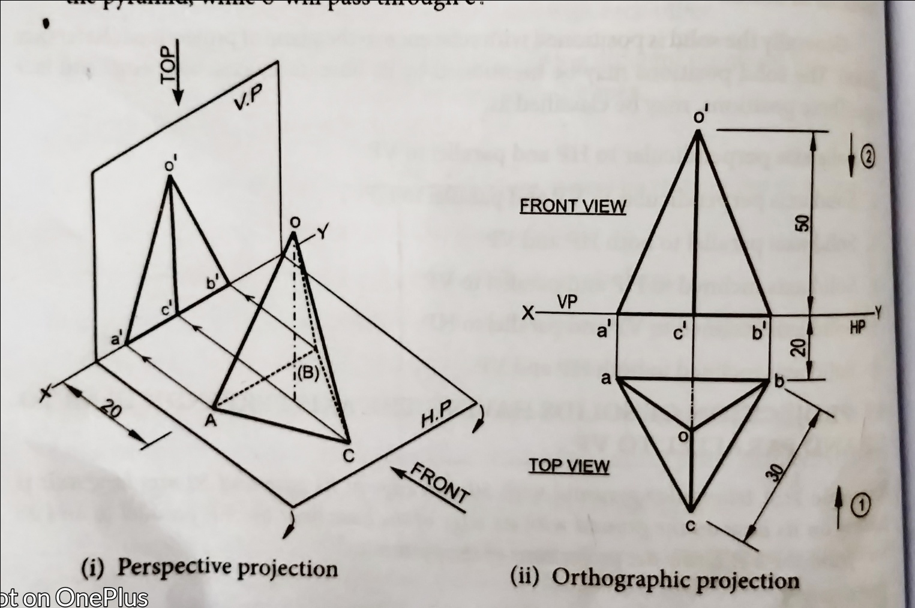
1) A triangular pyramid with 30mm edge at its base and 50mm long axis is resting on its base on the ground with an edge of the base near the VP, parallel to and 20 mm in front of VP. Draw the projections of the pyramid.

Slide 3
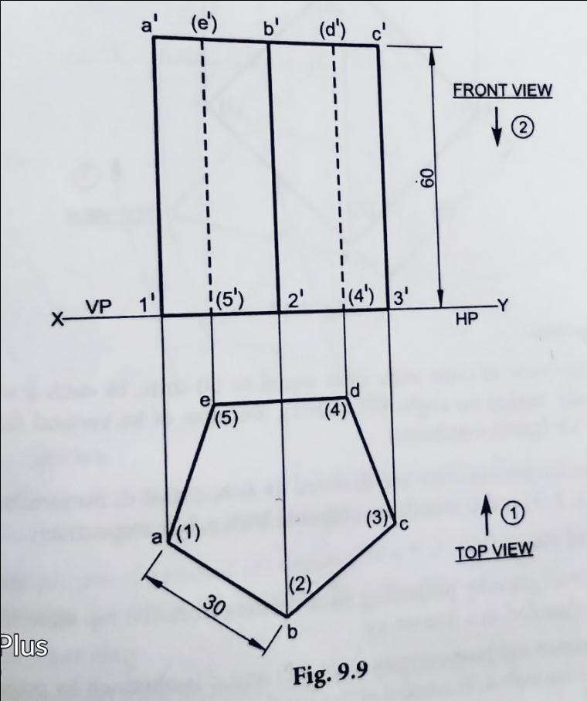
2) Draw the projections of a pentagonal prism of base side 30mm and axis length is 60mm resting on the HP on one of its bases with a side of base parallel to VP.

Slide 4
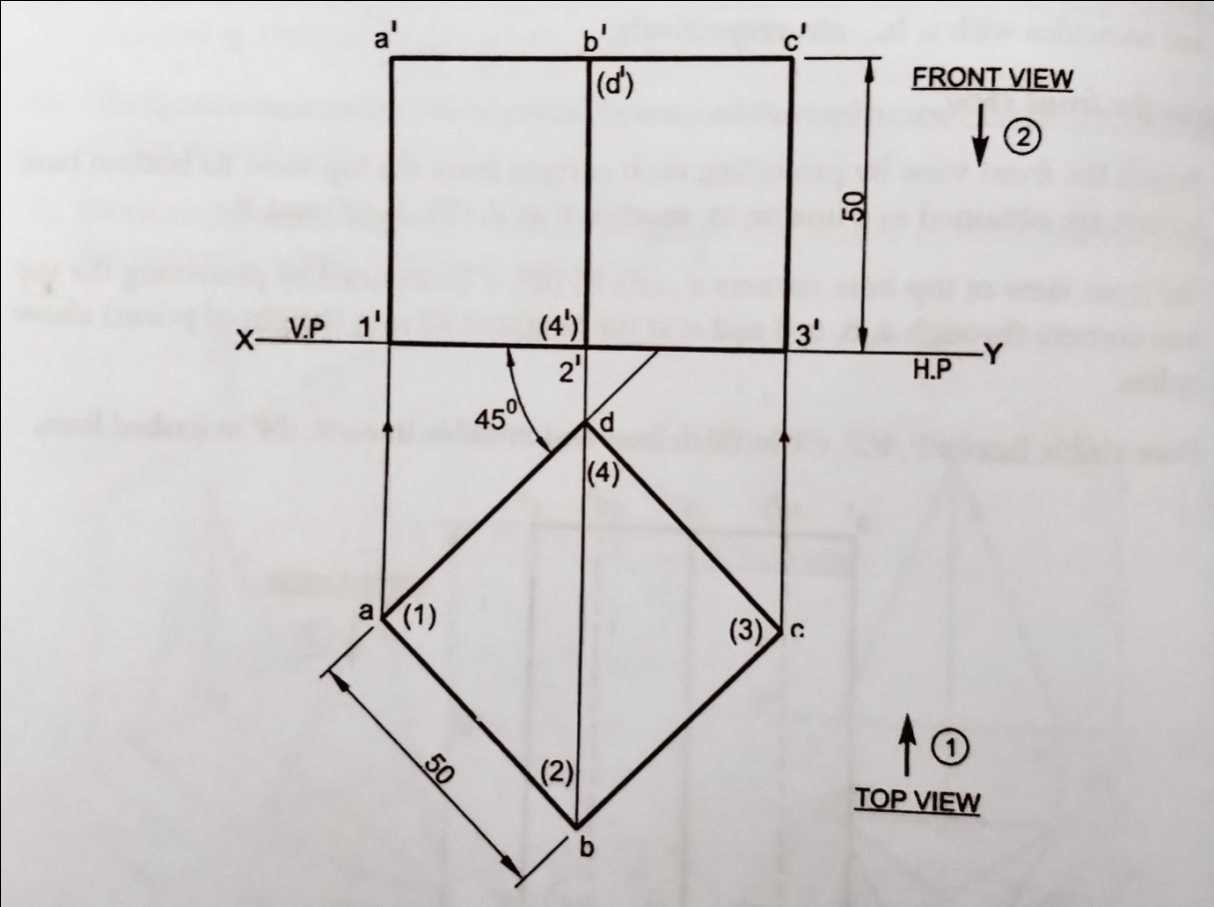
3) Draw the projections, when a cube of 50mm long edges is resting on the HP with its vertical faces equally inclined to VP.

Slide 5
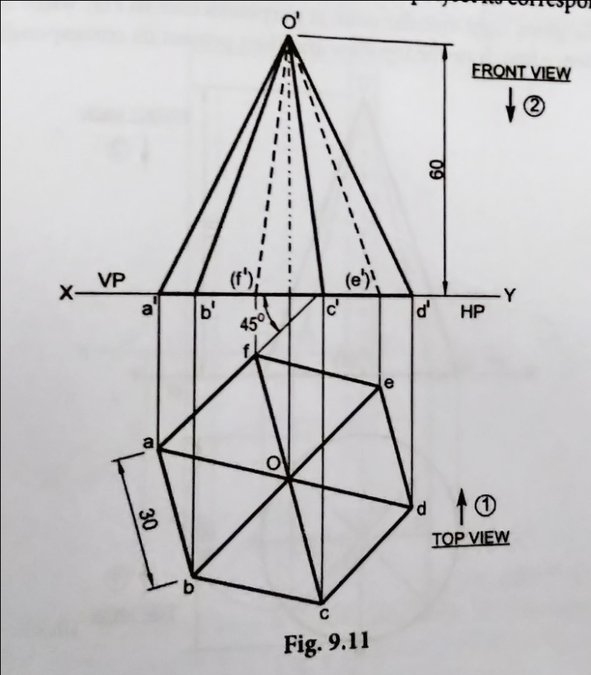
4) The hexagonal pyramid has base 30mm side and axis 60mm long is resting on the HP on its base and one of the edges of the base inclined at 45º to the VP.

Slide 6
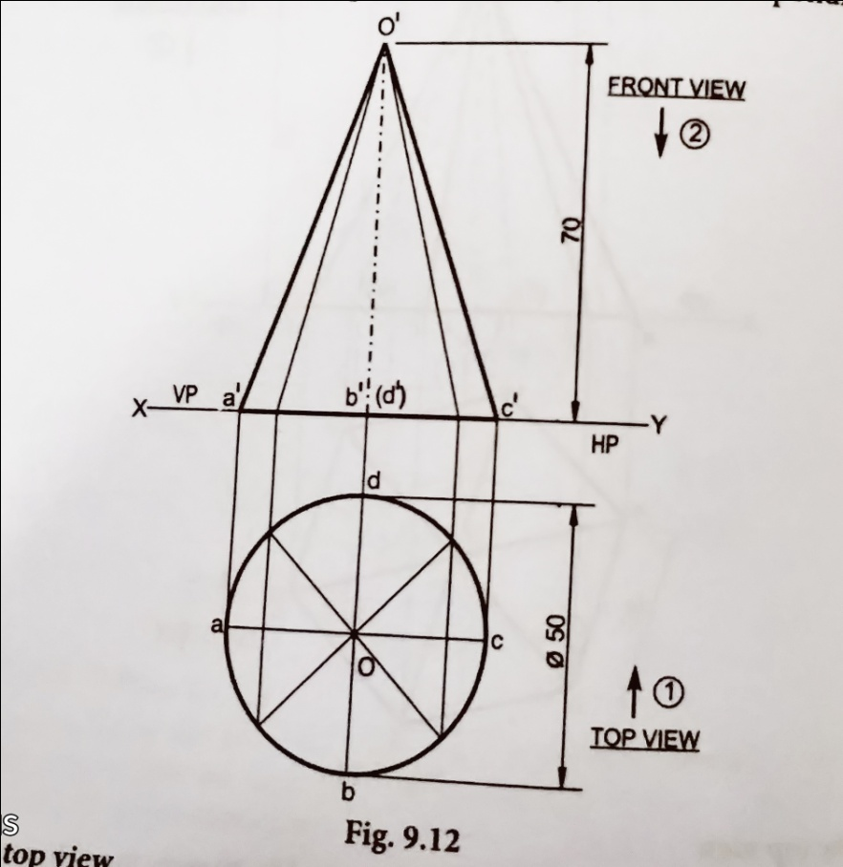
5) Draw the projections of a right circular cone of base 50mm diameter and height of 70mm, when resting with its base on the HP.

Slide 7
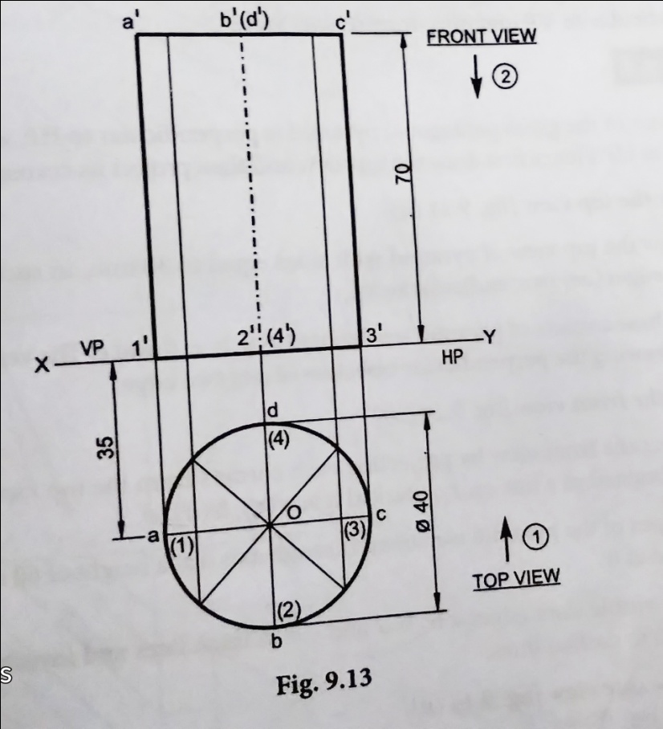
6) Draw the projections of a cylinder of base 40mm diameter and axis length 70mm long is resting on the HP on its base with its axis 35mm in front of VP.

Slide 8
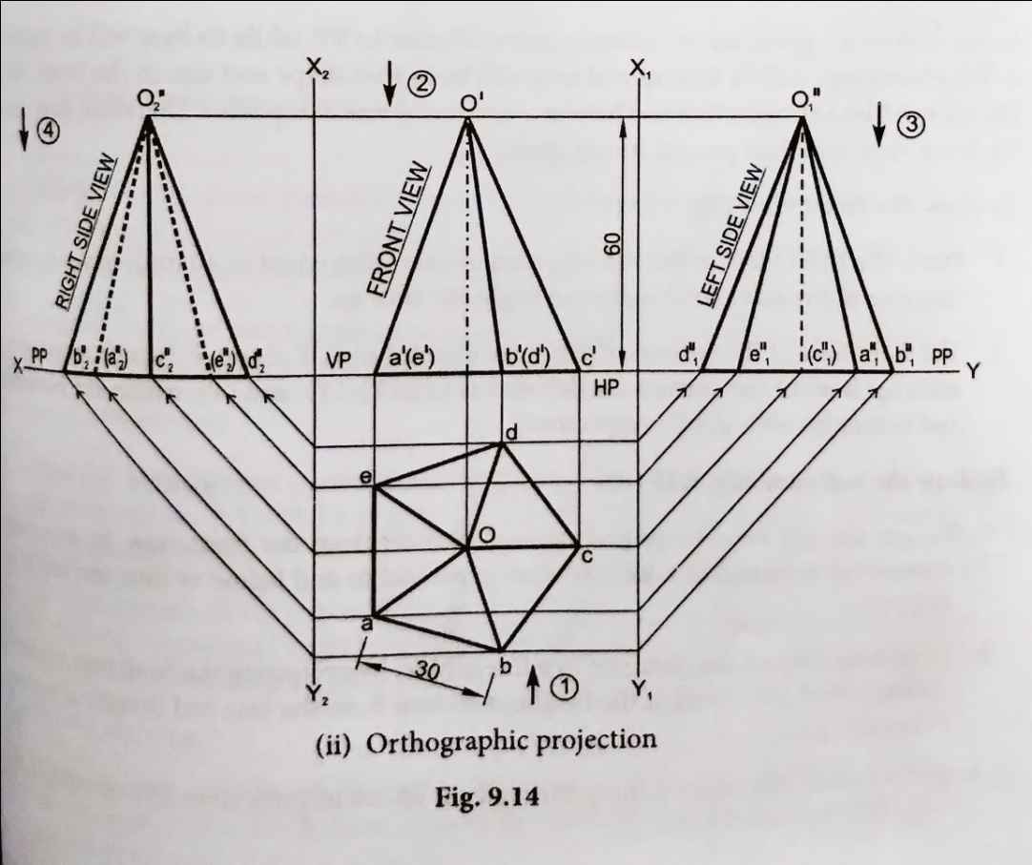
7) Draw the projections of a pentagonal pyramid has a base 30 mm edge and axis 60 mm long, having its base on the HP such that one of the edges of the base is perpendicular to VP and also draw its side view.

Slide 9
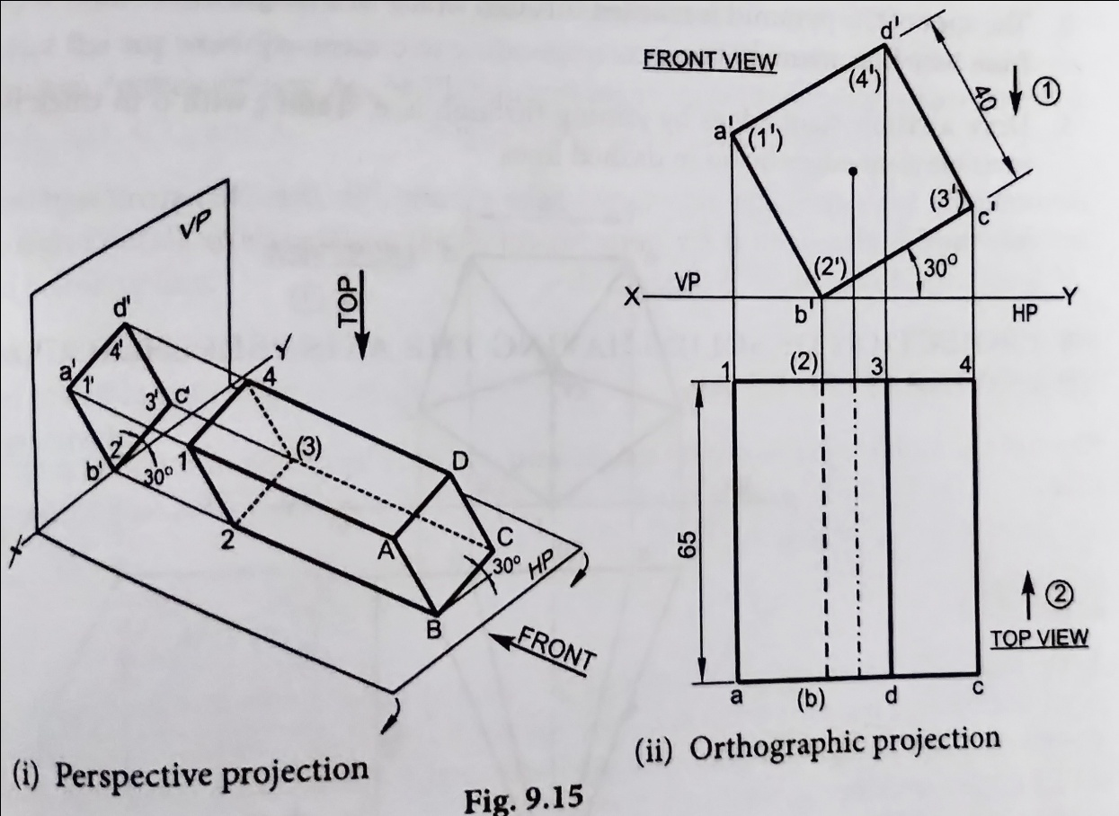
8) A square prism of base side 40 mm and axis 60mm long is kept on HP, such that its axis is perpendicular to VP. When one of its longer edges with its face containing the longer edge inclined at 30º to the HP.

Slide 10
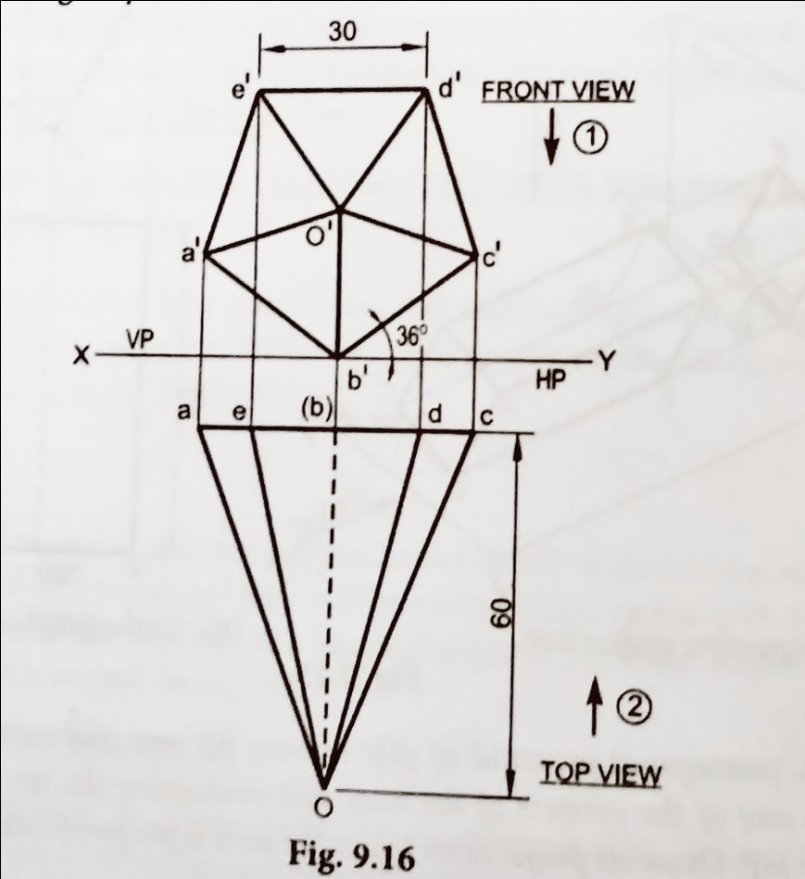
9) A pentagonal pyramid of side of base 30mm and axis 60mm long rests on the HP on one of the corners of the base side containing the rest corners are equally inclined to the HP. Draw its projections when the axis is perpendicular to VP.

Slide 11
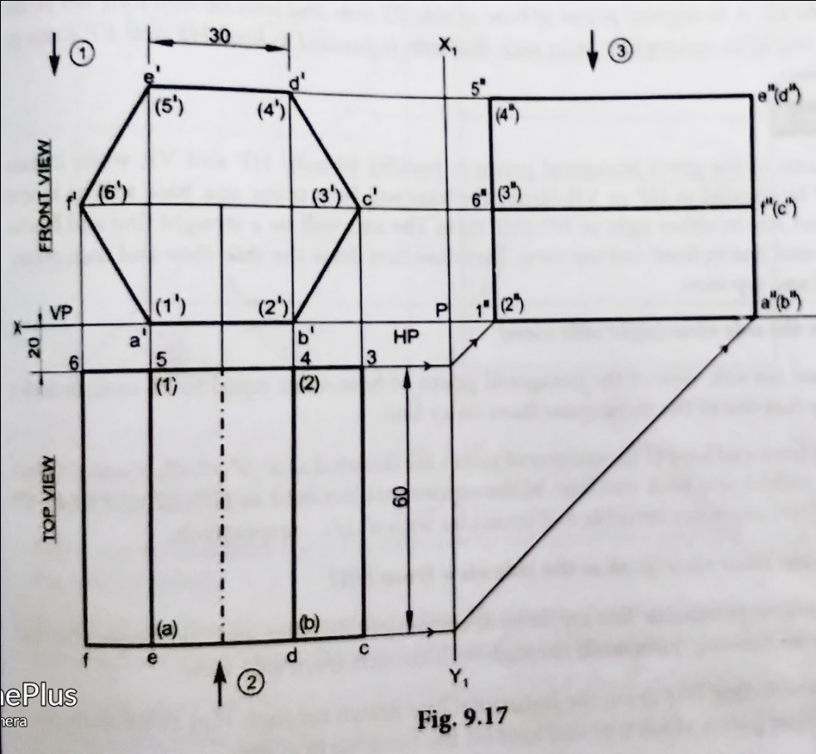
10) A hexagonal prism of base side 30mm and axis length 60mm is lying on the ground on one of its rectangular faces. Such that axis is perpendicular to VP. Draw its top, front and left-side views when the near end is 20mm in front of VP.

Slide 12
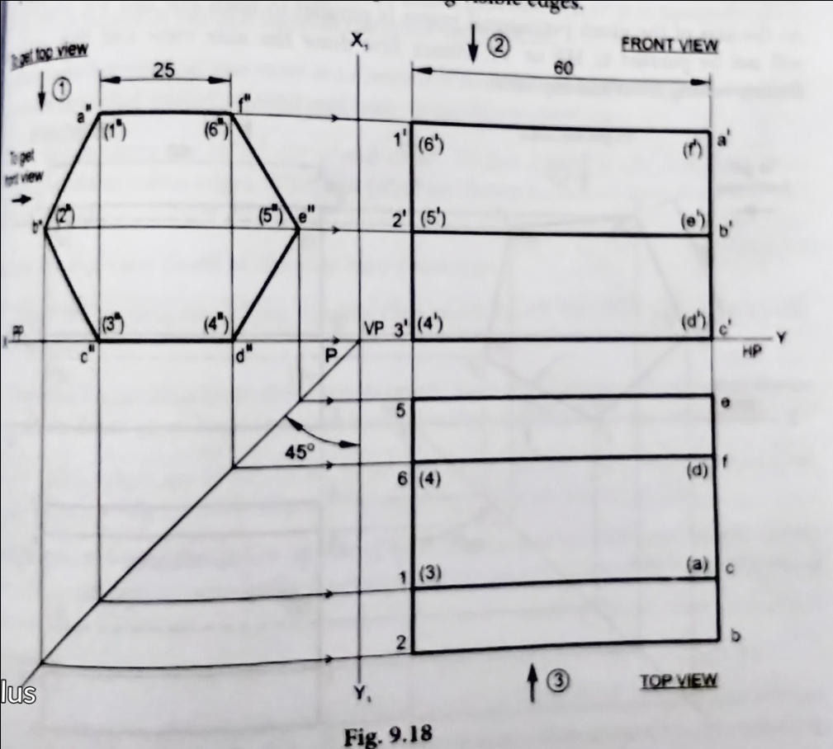
11) A hexagonal prism of base side 25mm and axis 60mm long lies on the ground one of its rectangular faces such that axis is parallel to both HP and VP. Draw its projections

Slide 13
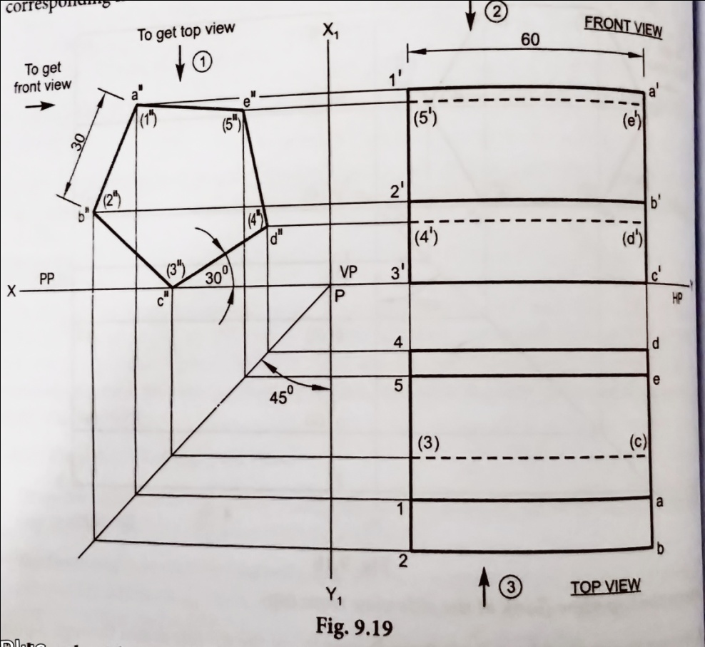
12) A pentagonal prism of side of base 30mm and axis 60mm long lies on the ground on one of its longer edges with its axis parallel to both HP and VP. Draw the top and front view when one of the rectangular faces containing the resting edge is inclined at 30⁰ to the ground.

Slide 14
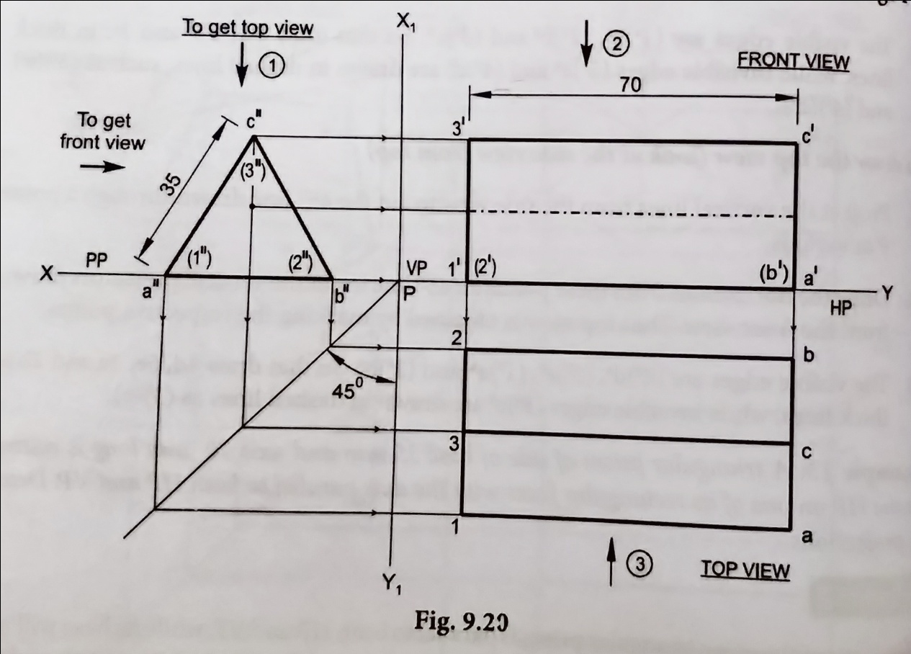
13) A triangular prism of side of base 35mm and 70mm long is resting on the HP on one of its rectangular faces with the axis parallel to both HP and VP. Draw its projections.

Slide 15
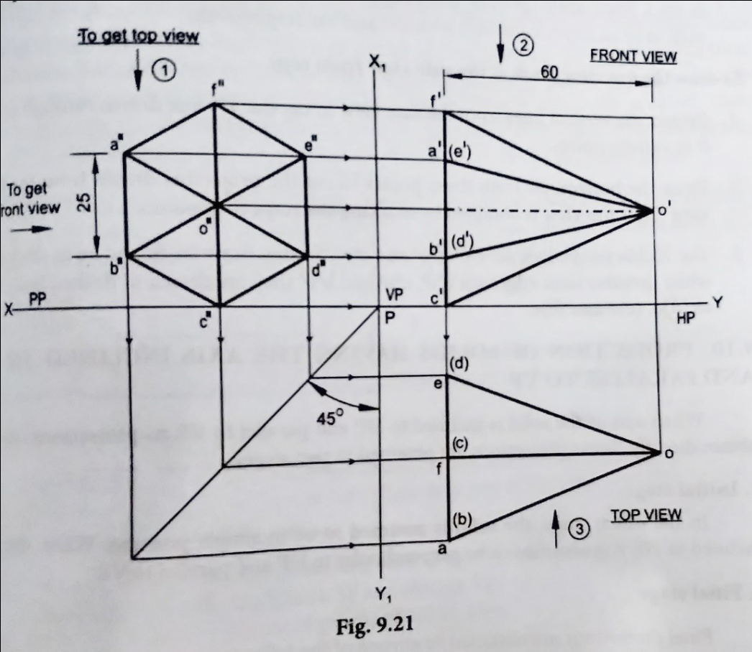
14) Draw the projections of a hexagonal pyramid of side of base 25mm and axis 60mm long is resting on the HP on one of its base corners with the sides containing the corner equally inclined to the HP and its axis parallel to both HP and VP.

Slide 16
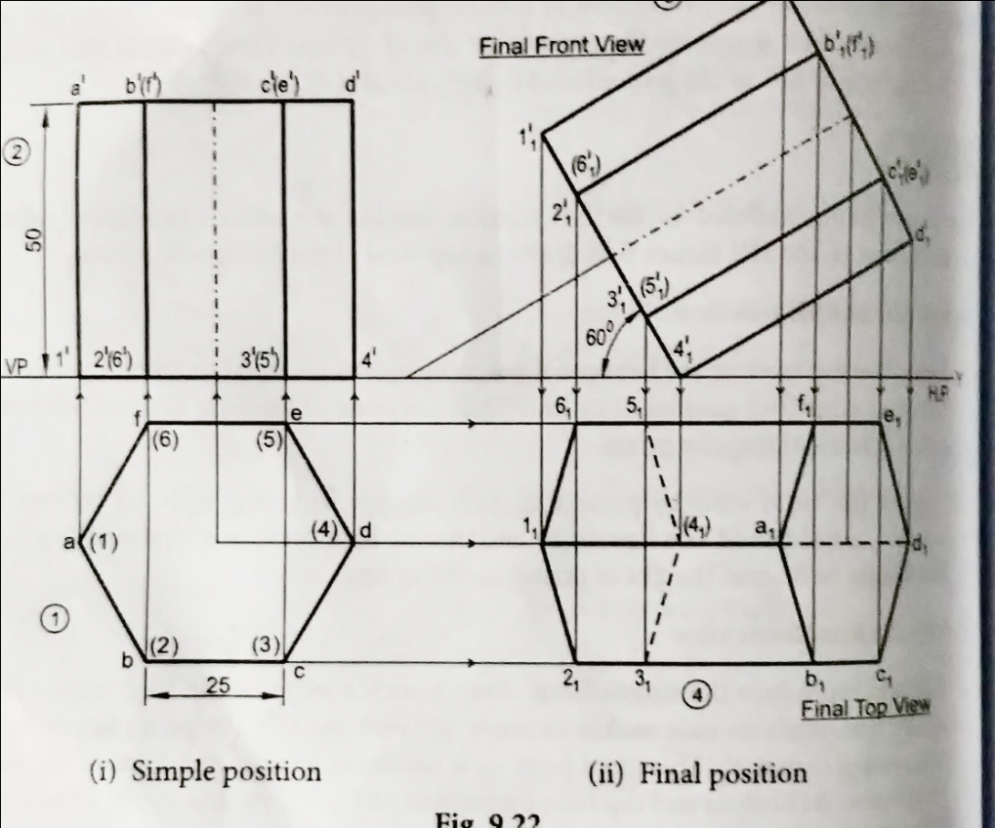
15) Draw the projections of a hexagonal prism of base side 25 mm and axis 50 mm lengths when it rest on the ground on one of its base corners. Such that its base makes an angle of 60⁰ to the ground and axis is parallel VP.

Slide 17
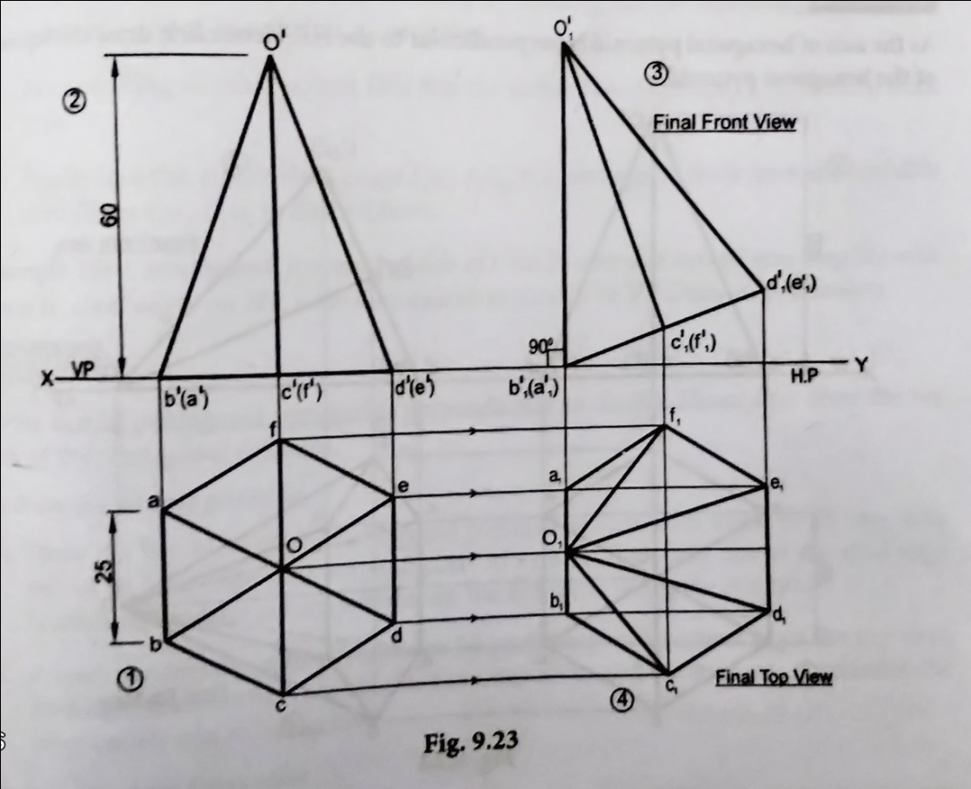
16) A hexagonal pyramid of 25 mm side of base and 60mm height rests on the HP on one of its base edges such that the triangular face containing the resting edge is perpendicular to both HP and VP. Draw its projections.

Slide 18
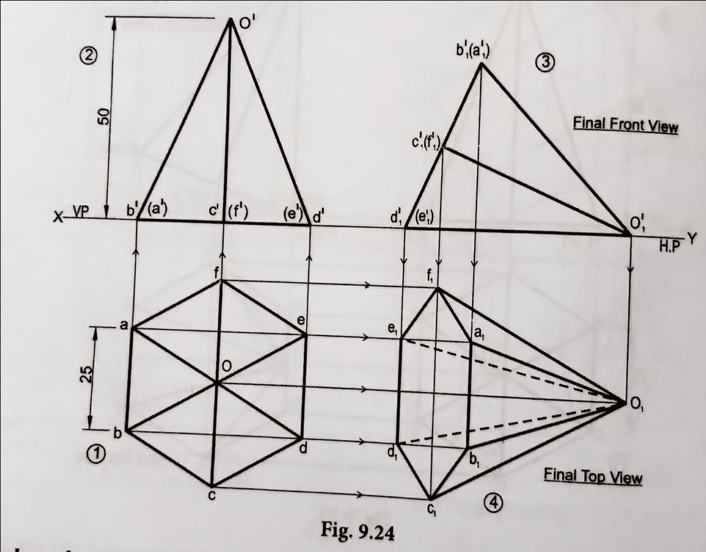
17) A hexagonal pyramid side of base 25 mm, axis 50mm long lying with one of its triangular face on the HP and its axis is parallel to the VP.

Slide 19
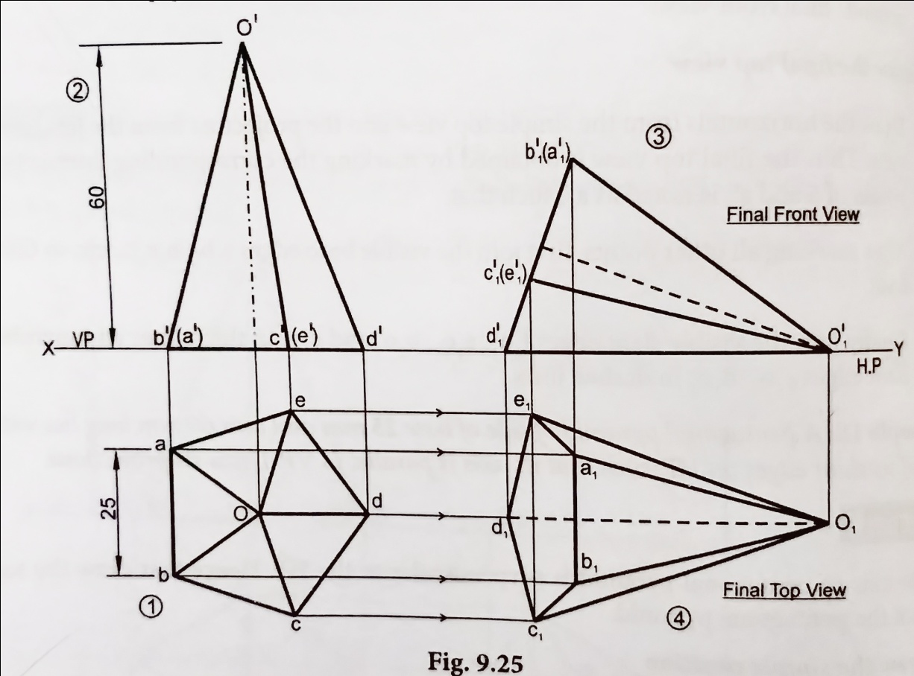
18) A pentagonal pyramid of side of base 25 mm and axis 60mm long lies with one of its slant edges on HP. Such that its axis is parallel to VP. Draw its projections.

Slide 20
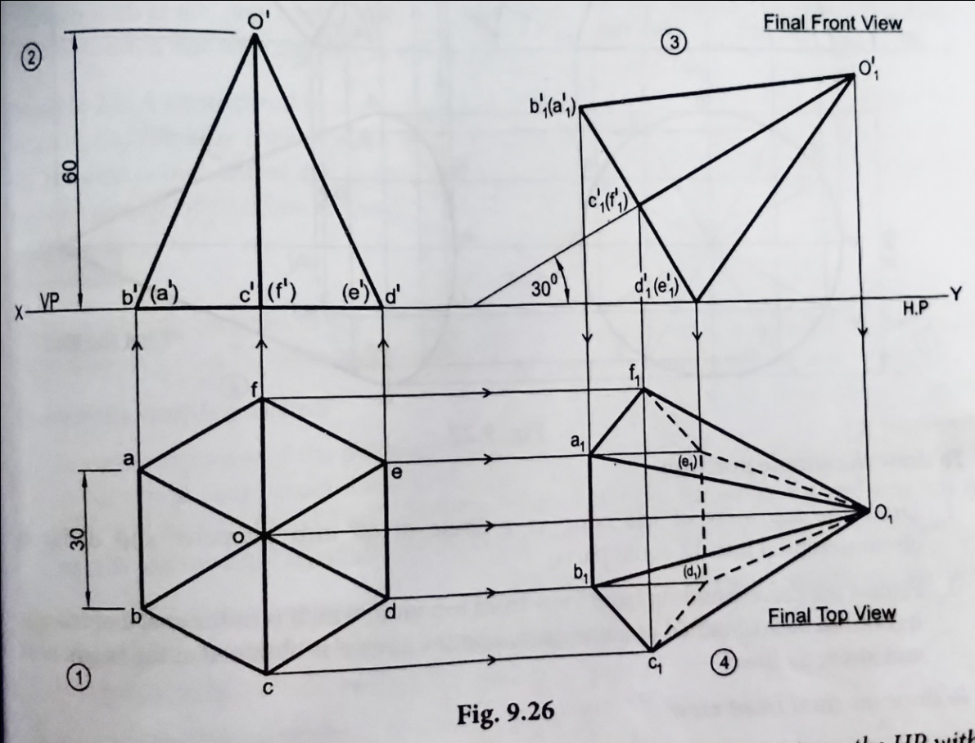
19) A hexagonal pyramid of side of base 30 mm and axis 60mm long has an edge of its base on the ground. Its axis is inclined at 30⁰ to the ground and parallel to VP. Draw its projections.

Slide 21
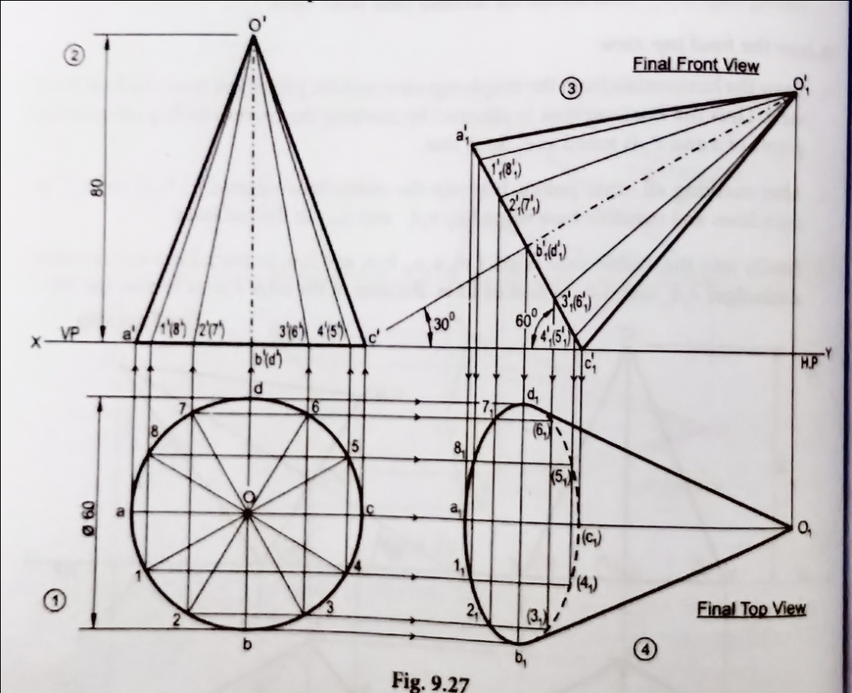
20) A cone of base 60 mm diameter and altitude 80 mm rests on the HP with its axis inclined at 30⁰ to the HP and parallel to the VP. Draw its top and front views.

Slide 22
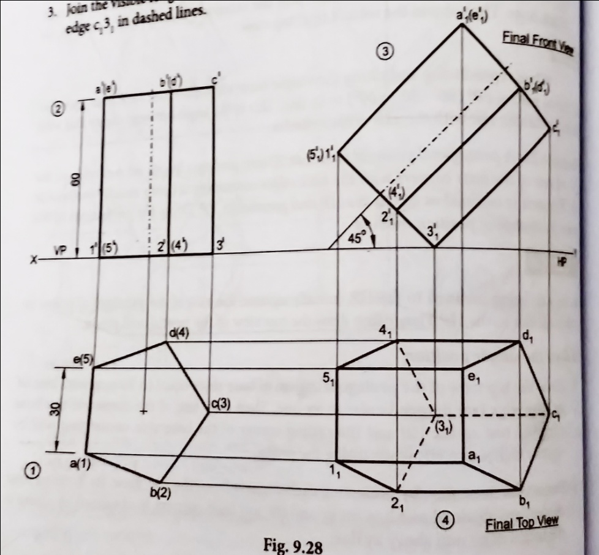
21) A pentagonal prism of base side 30mm and axis length 60mm rests on the HP on one of the base corners with the base edges containing it being equally inclined to HP. The axis is inclined at 45⁰ to the HP and parallel to the VP. Draw the projections of the prism by change of position method.

Slide 23
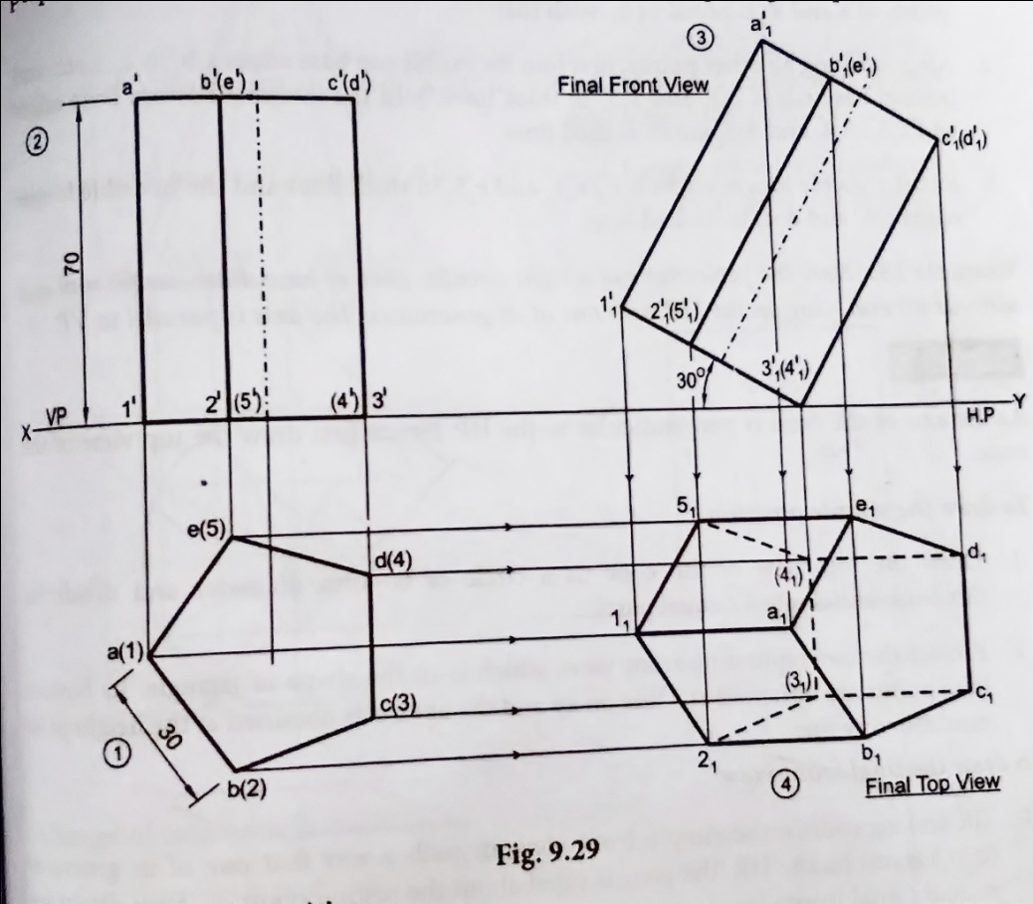
22) A pentagonal prism of side 30mm and axis 70 mm long rests with one of its edges on HP such that the base containing that edge makes an angle of 30⁰ to HP and its axis is parallel to VP. Draw its projections.

Slide 24
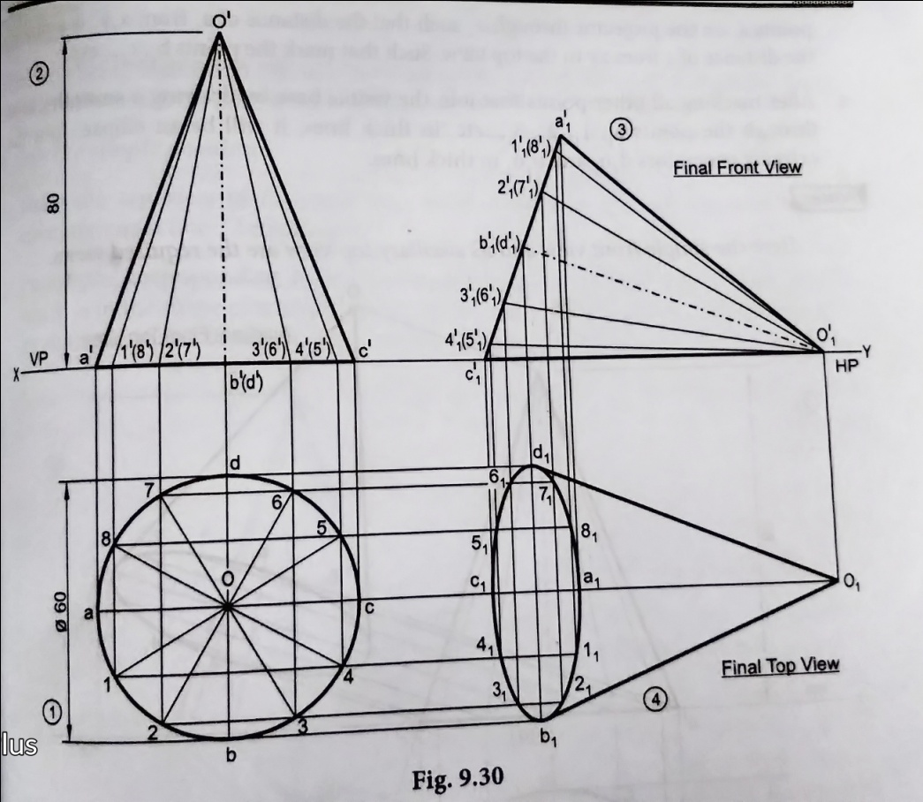
23) Draw the projections of a right circular cone of base diameter 60mm and altitude 80mm lying on the HP with one of its generators. The axis is parallel to VP.

Slide 25
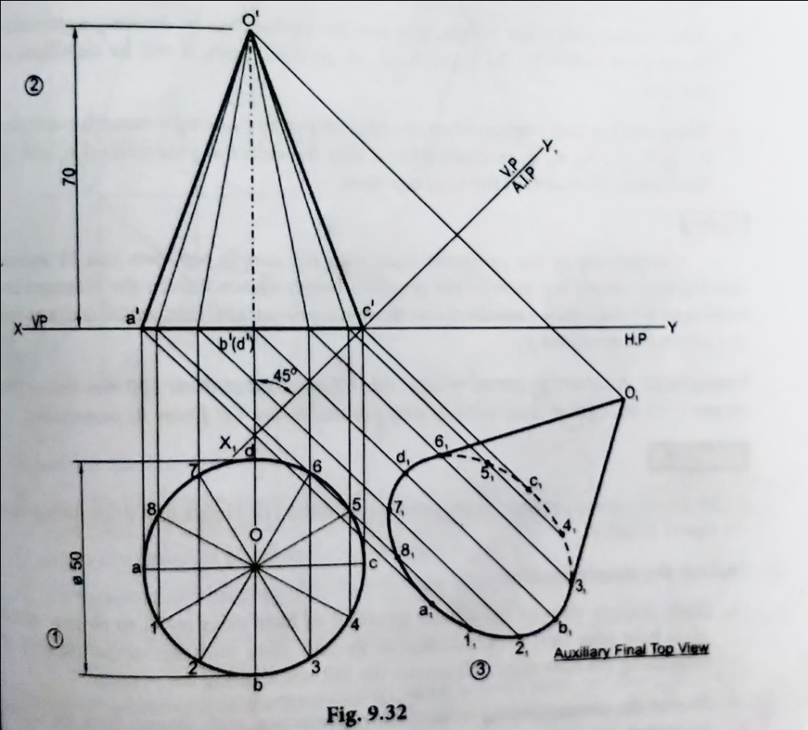
24) Draw the projections of a right circular cone of base diameter 50 mm and altitude 70 mm when it rests on the ground with its axis inclined at 45⁰ to the ground and parallel to VP (change of reference line method).

Slide 26
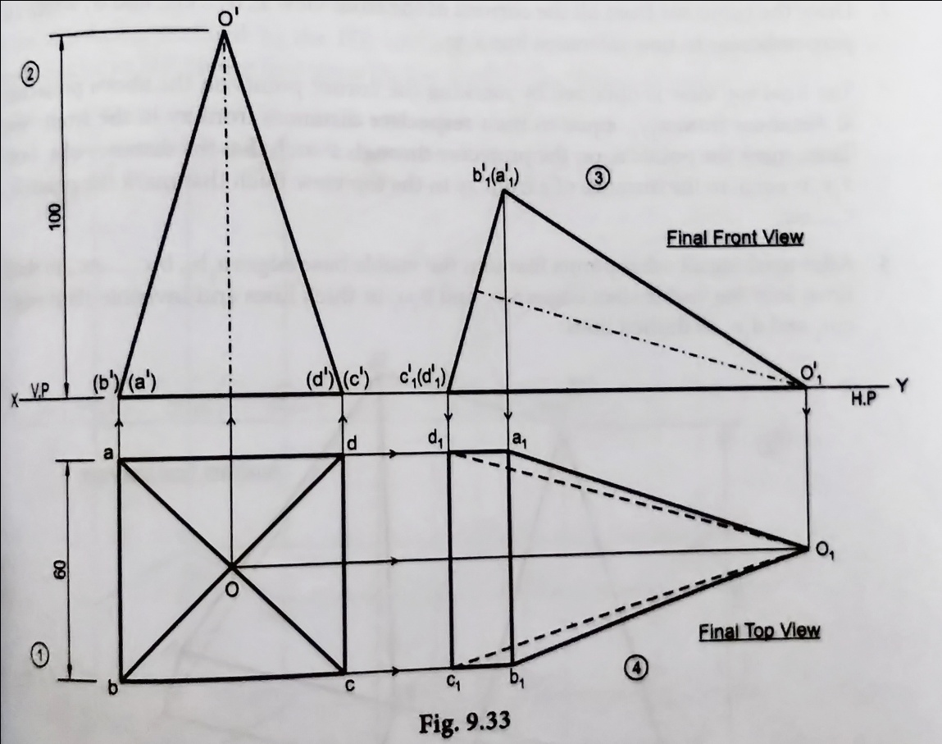
25) A square pyramid of the base side 60mm and altitude 100 mm lies on the HP on one of its triangular faces with its axis parallel to the VP. Draw its projections.

Slide 27
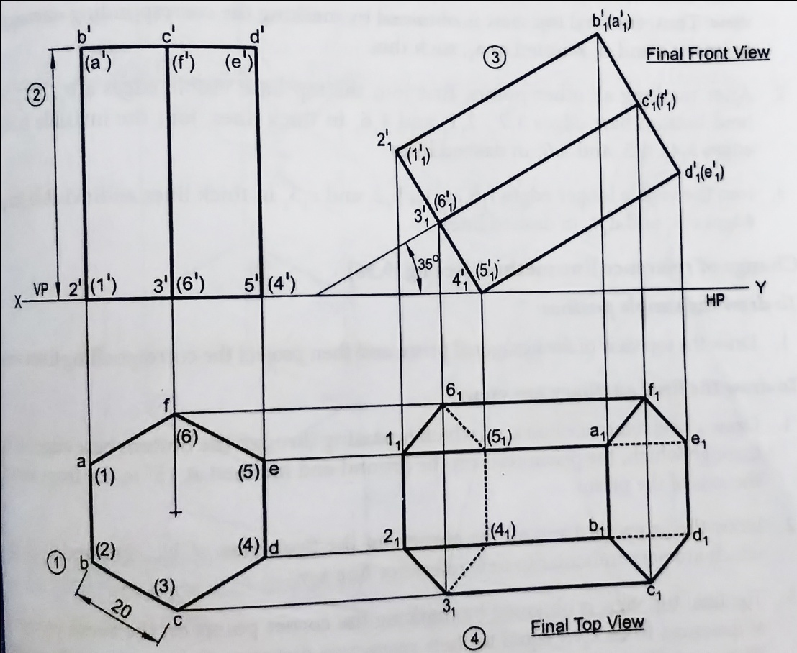
26) Draw the projections of a hexagonal prism of base side 20 mm and axis length 50 mm when it rests on the ground on one of the edges of the base and the axis inclined at 35⁰ to the ground and parallel to the VP.

Slide 28
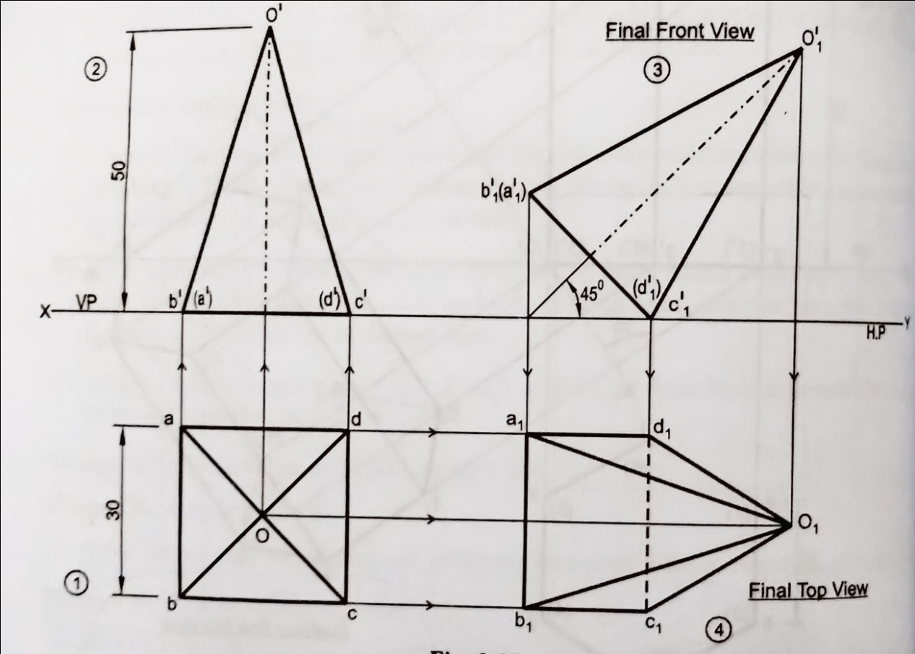
27) A square pyramid of base side 30 mm and height 50 mm rests on the ground on one of its base edges such that its axis is inclined at 45⁰ to the ground and parallel to VP. Draw its projections.

Slide 29
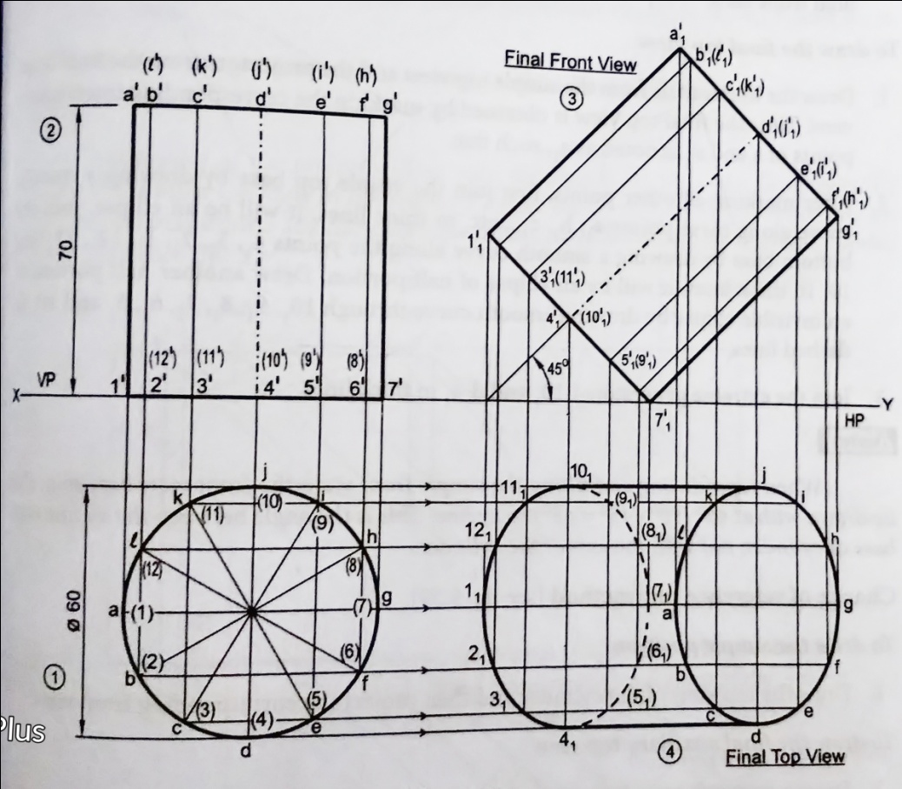
28) A cylinder, diameter of base 60 mm and height 70 mm, is having a point of its periphery of base on HP with axis of the cylinder inclined to HP at 45⁰ and parallel to VP. Draw the projections of the cylinder.

Slide 30
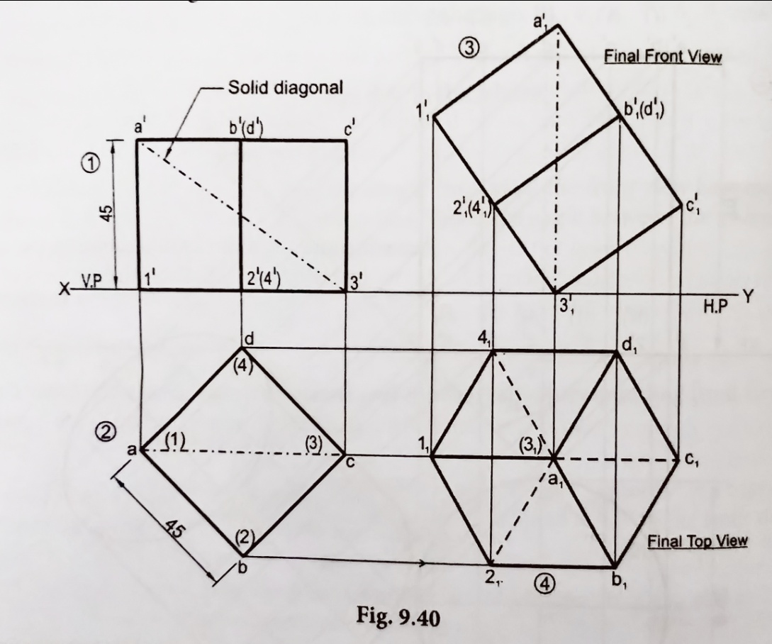
29) Draw the projections of a cube of edge 45 mm resting on one of its corners on the HP, with a solid diagonal perpendicular to HP.

Slide 31
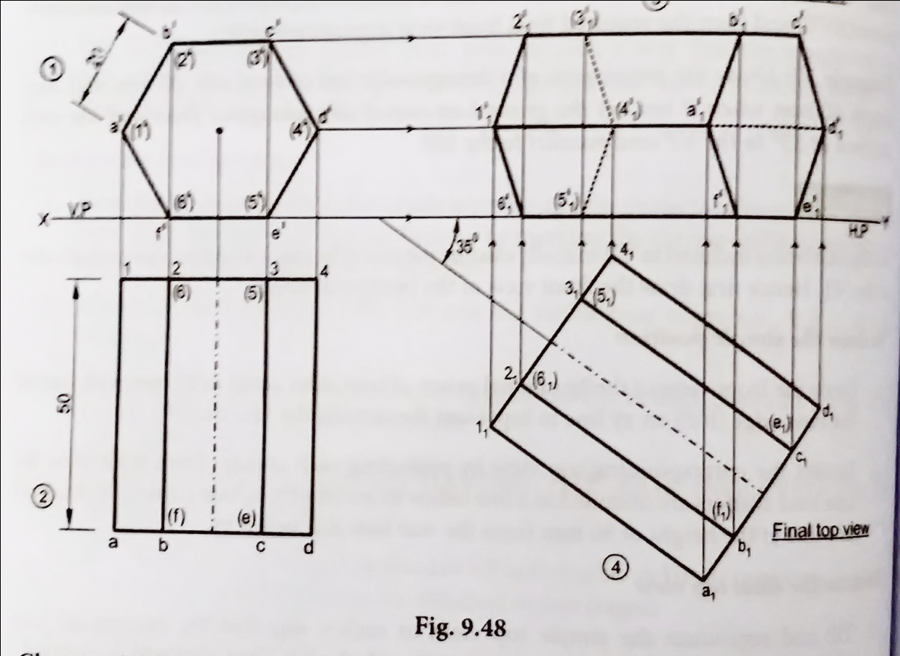
30) Draw the projections of a hexagonal prism of base side 20 mm and axis length 50 mm when it rest on the ground on one of its rectangular faces and the axis is inclined at 35⁰ to the VP and parallel to the HP.

Slide 32
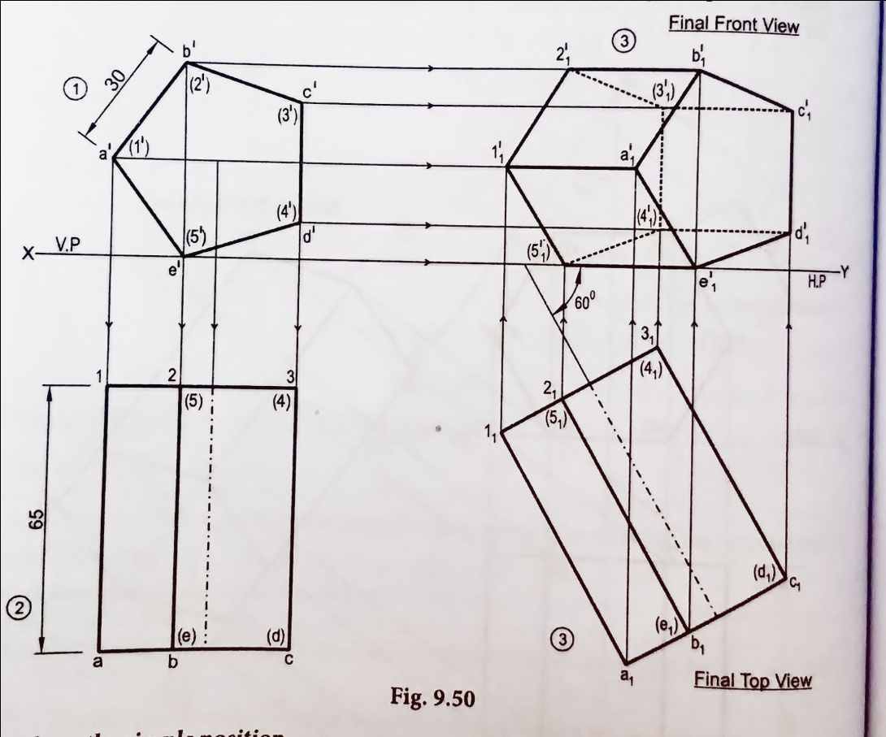
31) Draw the projections of a pentagonal prism of 30 mm side of base and 65 mm long. Its lying on one of its longer edges on HP with one rectangular face perpendicular to HP such that axis makes an angle 60⁰ with VP.

Slide 33
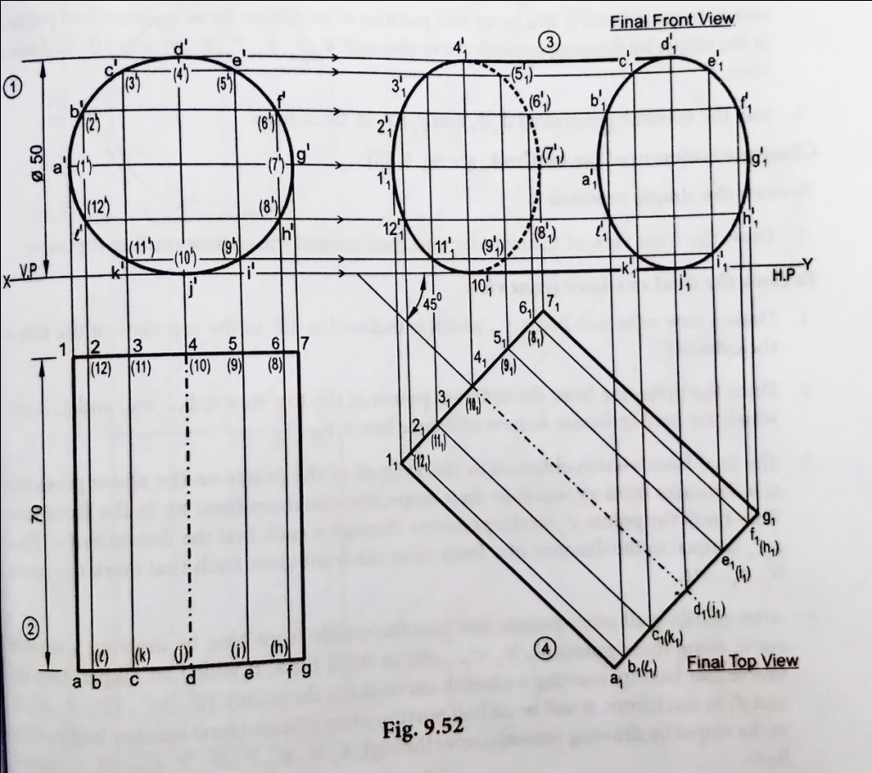
32) Draw the projections of a cylinder of base diameter 50 mm and axis length 70 mm when it is lying on one of its generators on HP, with its axis inclined at 45⁰ to VP.

Slide 34
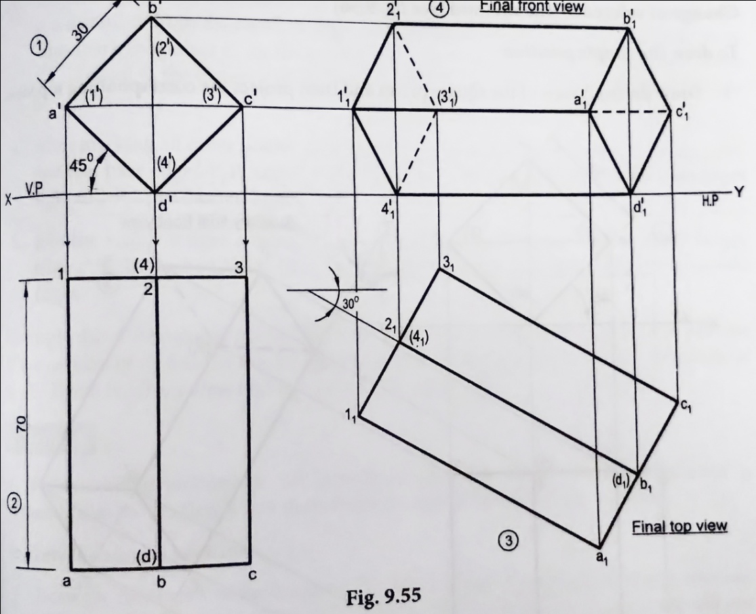
33) A square prism of base side 30 mm and axis 70 mm rests on HP on one of the longer edges with rectangular faces equally inclined to HP. The axis is inclined at 30⁰ to VP. Draw the top and front views of the prism.

Slide 35
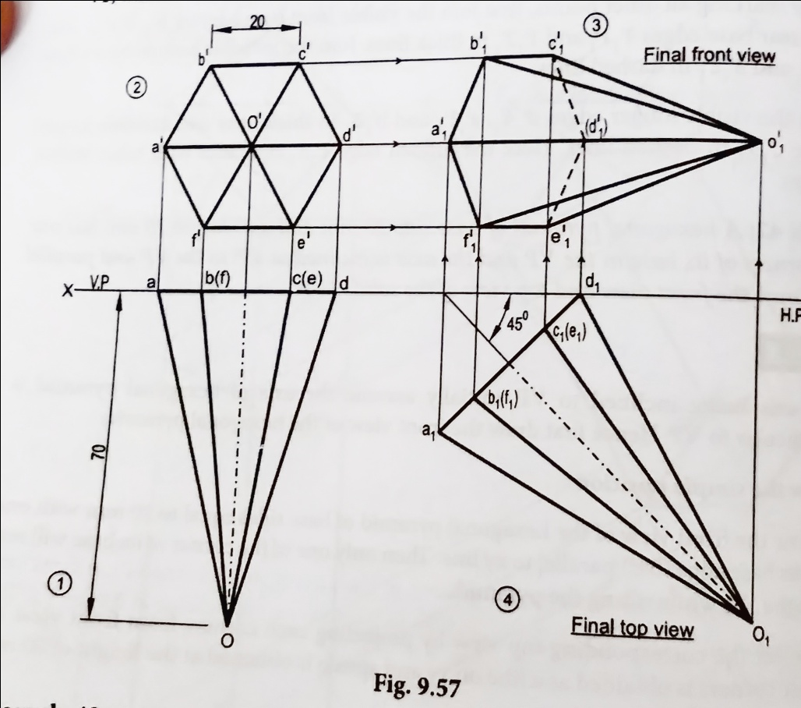
34) A hexagonal pyramid of base side 20 mm and axis height 70 mm has one of the corners of its base in the VP and axis is inclined at 45⁰ to the VP and parallel to HP. Hence draw the front view and top view of the pyramid.

Slide 36
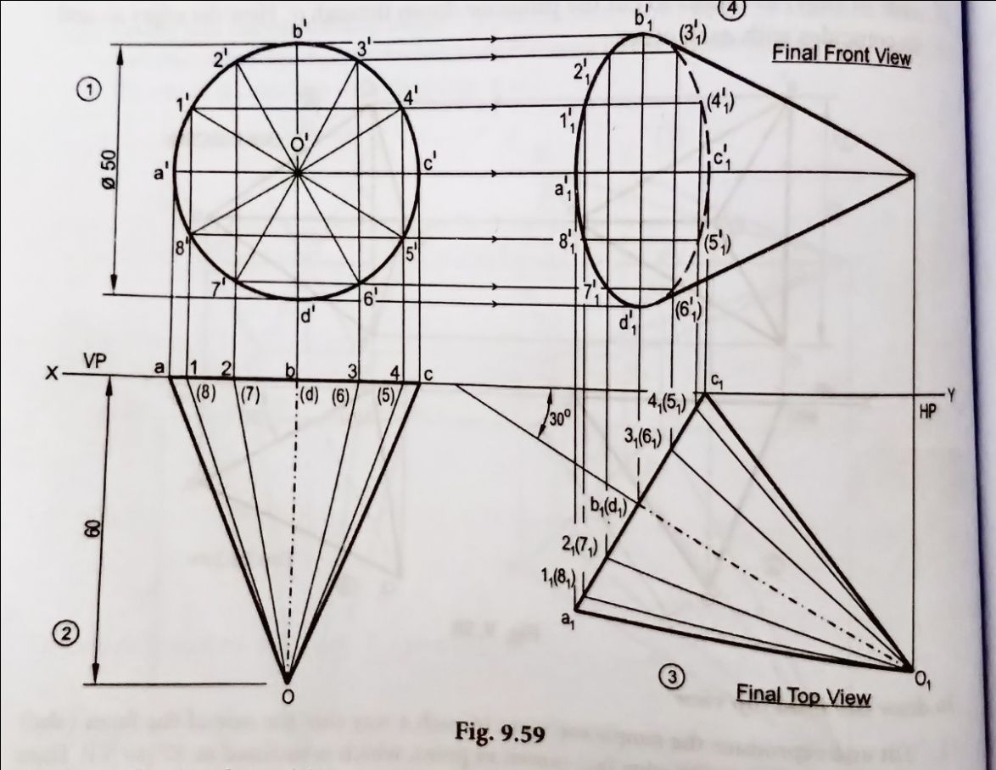
35) Draw the projections of a right circular cone of base diameter 50 mm and axis 60 mm long, touches the VP on a point of its base circle. Its axis is inclined at 30⁰ to VP and parallel to HP.

Slide 37
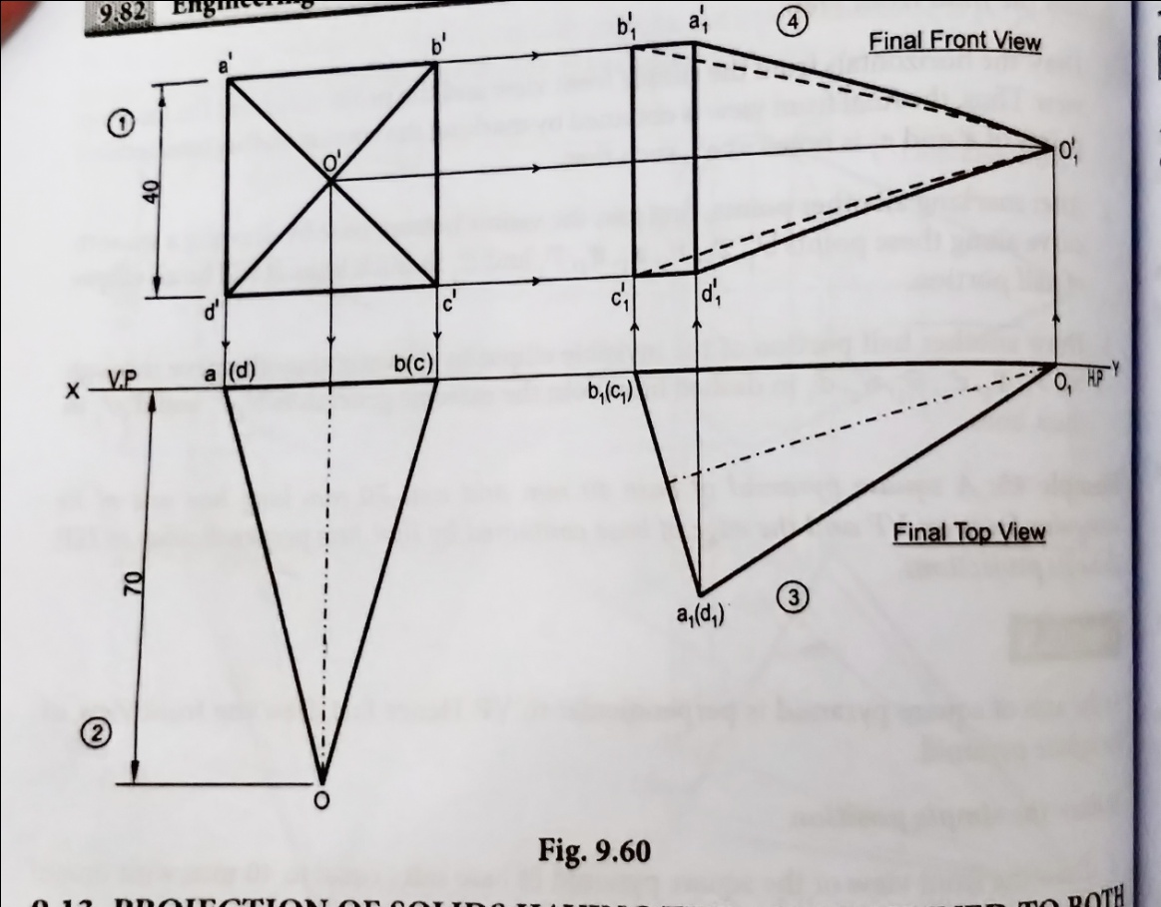
36) A square pyramid of base 40 mm and axis 70 mm long has one of its triangular faces on VP and edge of base contained by that face perpendicular to HP. Draw its projections.

Slide 38
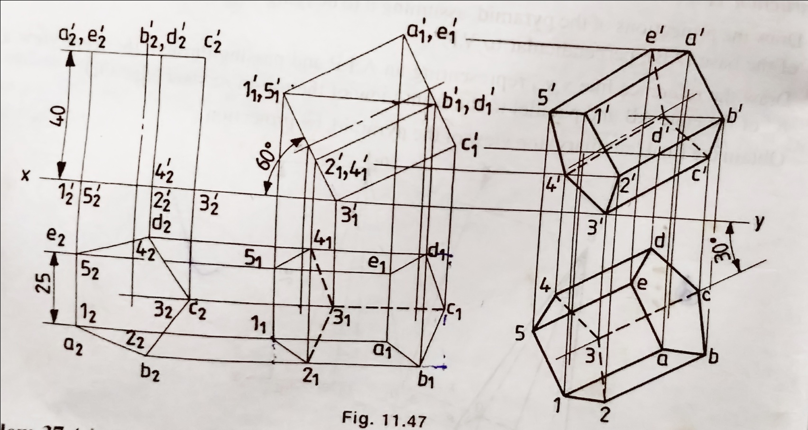
37) A pentagonal prism of side of base 25 mm and axis 40 mm long, resting on HP on a corner of its base. Draw the projections of a prism, when the base is inclined at 60⁰ to HP and the axis appears to be inclined at 30⁰ to VP. Follow the change of position method.

Slide 39
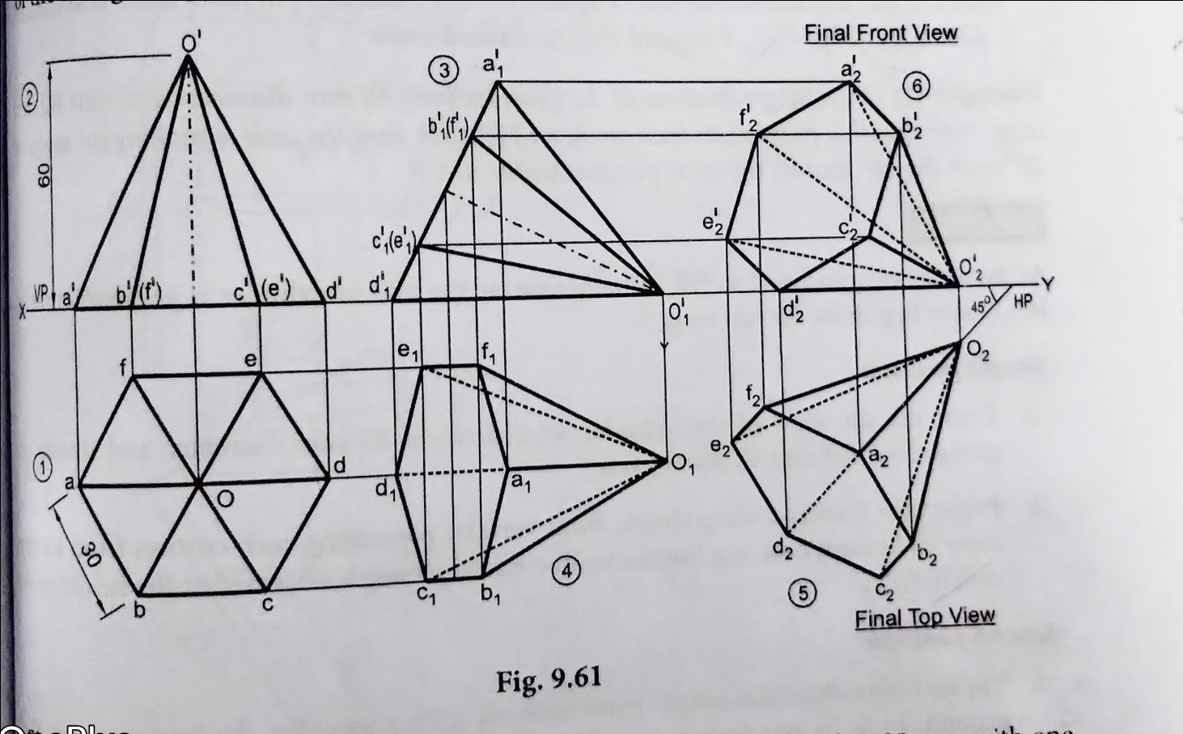
38) Draw the projections of a hexagonal pyramid of base side 30 mm and axis 60 mm long has one of its slant edges on HP such that two of its triangular faces containing the slant edges on which its rest are equally inclined to HP. The top view of the axis appears to be inclined at 45⁰ to VP and its base is nearer to the observer than its apex.

Slide 40
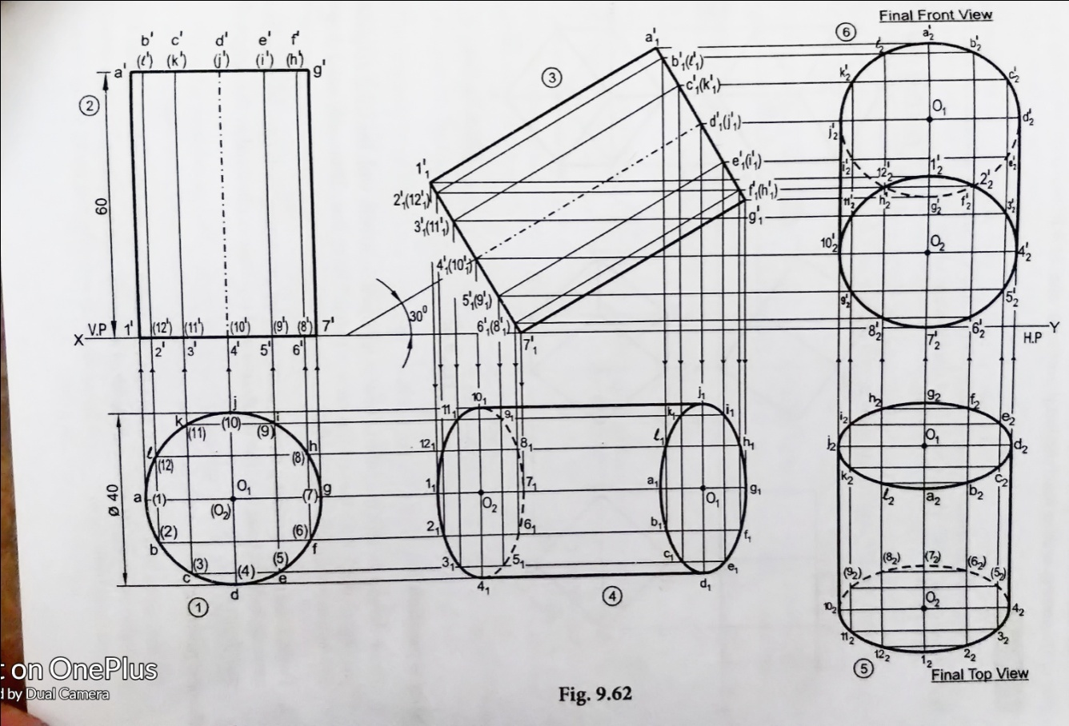
39) Draw the projections of the cylinder base 40 mm diameter and axis 60 mm long, resting with a point of its base circle on HP, such that the axis is making an angle of 30⁰ with the HP and its top view perpendicular to VP.

Slide 41
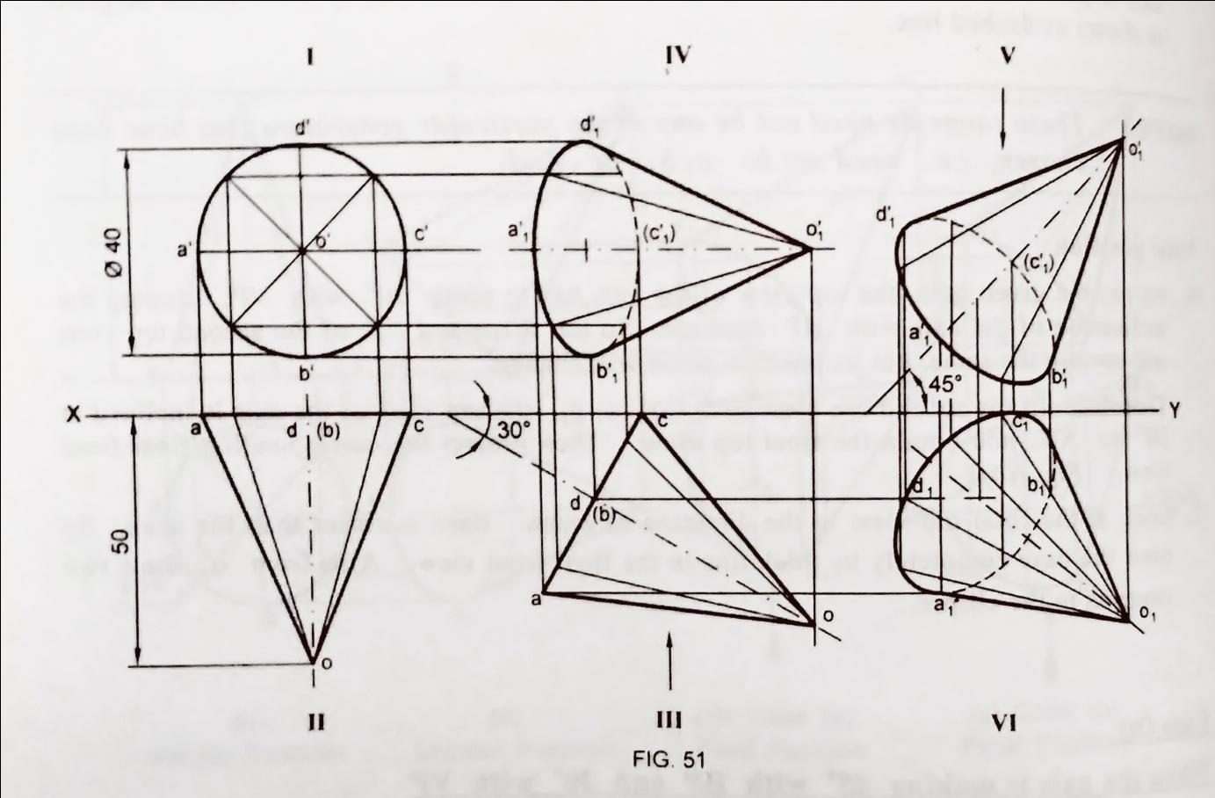
40) A cone 40 mm base and axis 50mm long touches the VP on a point of its base circle. The axis is inclined at 30⁰ to VP and the front view of the axis is inclined at 45⁰ to HP. Draw its projections.

Slide 42
Example questions for practice
A triangular pyramid with 30mm edge at its base and 50mm long axis is resting on its base on the ground with an edge of the base near the VP, parallel to and 20 mm in front of VP. Draw the projections of the pyramid.
Draw the projections of a pentagonal prism of base side 30mm and axis length is 60mm resting on the HP on one of its bases with a side of base parallel to VP.
Draw the projections, when a cube of 50mm long edges is resting on the HP with its vertical faces equally inclined to VP.
The hexagonal pyramid has base 30mm side and axis 60mm long is resting on the HP on its base and one of the edges of the base inclined at 45º to the VP.
Draw the projections of a right circular cone of base 50mm diameter and height of 70mm, when resting with its base on the HP.

Slide 43
Draw the projections of a cylinder of base 40mm diameter and axis length 70mm long is resting on the HP on its base with its axis 35mm in front of VP.
Draw the projections of a pentagonal pyramid has a base 30 mm edge and axis 60 mm long, having its base on the HP such that one of the edges of the base is perpendicular to VP and also draw its side view,
A square prism of base side 40 mm and axis 60mm long, is kept on HP, such that its axis is perpendicular to VP. When one of its longer edges with its face containing the longer edge inclined at 30º to the HP.
A pentagonal pyramid of side of base 30mm and axis 60mm long rests on the HP on one of the corners of the base side containing the rest corners are equally inclined to the HP. Draw its projections when the axis is perpendicular to VP.
A hexagonal prism of base side 30mm and axis length 60mm is lying on the ground on one of its rectangular faces. Such that axis is perpendicular to VP. Draw its top, front and left-side views when the near end is 20mm in front of VP.

Slide 44
A hexagonal prism of base side 25mm and axis 60mm long lies on the ground one of its rectangular faces such that axis is parallel to both HP and VP. Draw its projections.
A pentagonal prism of side of base 30mm and axis 60mm long lies on the ground on one of its longer edges with its axis parallel to both HP and VP. Draw the top and front view when one of the rectangular faces containing the resting edge is inclined at 30⁰ to the ground.
A triangular prism of side of base 35mm and 70mm long is resting on the HP on one of its rectangular faces with the axis parallel to both HP and VP. Draw its projections.
Draw the projections of a hexagonal pyramid of side of base 25mm and axis 60mm long is resting on the HP on one of its base corners with the sides containing the corner equally inclined to the HP and its axis parallel to both HP and VP.
Draw the projections of a hexagonal prism of base side 25 mm and axis 50 mm lengths when it rest on the ground on one of its base corners. Such that its base makes an angle of 60⁰ to the ground and axis is parallel VP.

Slide 45
A hexagonal pyramid of 25 mm side of base and 60mm height rests on the HP on one of its base edges such that the triangular face containing the resting edge is perpendicular to both HP and VP. Draw its projections.
A hexagonal pyramid side of base 25 mm, axis 50mm long lying with one of its triangular face on the HP and its axis is parallel to the VP.
A pentagonal pyramid of side of base 25 mm and axis 60mm long lies with one of its slant edges on HP. Such that its axis is parallel to VP. Draw its projections.
A hexagonal pyramid of side of base 30 mm and axis 60mm long has an edge of its base on the ground. Its axis is inclined at 30⁰ to the ground and parallel to VP. Draw its projections.
A cone of base 60 mm diameter and altitude 80 mm rests on the HP with its axis inclined at 30⁰ to the HP and parallel to the VP. Draw its top and front views.

Slide 46
A pentagonal prism of base side 30mm and axis length 60mm rests on the HP on one of the base corners with the base edges containing it being equally inclined to HP. The axis is inclined at 45⁰ to the HP and parallel to the VP. Draw the projections of the prism by change of position method.
A pentagonal prism of side 30mm and axis 70 mm long rests with one of its edges on HP such that the base containing that edge makes an angle of 30⁰ to HP and its axis is parallel to VP. Draw its projections.
Draw the projections of a right circular cone of base diameter 60mm and altitude 80mm lying on the HP with one of its generators. The axis is parallel to VP.
Draw the projections of a right circular cone of base diameter 50 mm and altitude 70 mm when it rests on the ground with its axis inclined at 45⁰ to the ground and parallel to VP ( change of reference line method).
A square pyramid of the base side 60mm and altitude 100 mm lies on the HP on one of its triangular faces with its axis parallel to the VP. Draw its projections.

Slide 47
Draw the projections of a hexagonal prism of base side 20 mm and axis length 50 mm when it rests on the ground on one of the edges of the base and the axis inclined at 35⁰ to the ground and parallel to the VP.
A square pyramid of base side 30 mm and height 50 mm rests on the ground on one of its base edges such that its axis is inclined at 45⁰ to the ground and parallel to VP. Draw its projections.
A cylinder, diameter of base 60 mm and height 70 mm, is having a point of its periphery of base on HP with axis of the cylinder inclined to HP at 45⁰ and parallel to VP. Draw the projections of the cylinder.
Draw the projections of a cube of edge 45 mm resting on one of its corners on the HP, with a solid diagonal perpendicular to HP.
Draw the projections of a hexagonal prism of base side 20 mm and axis length 50 mm when it rest on the ground on one of its rectangular faces and the axis is inclined at 35⁰ to the VP and parallel to the HP.

Slide 48
Draw the projections of a pentagonal prism of 30 mm side of base and 65 mm long. Its lying on one of its longer edges on HP with one rectangular face perpendicular to HP such that axis makes an angle 60⁰ with VP.
Draw the projections of a cylinder of base diameter 50 mm and axis length 70 mm when it is lying on one of its generators on HP, with its axis inclined at 45⁰ to VP.
A square prism of base side 30 mm and axis 70 mm rests on HP on one of the longer edges with rectangular faces equally inclined to HP. The axis is inclined at 30⁰ to VP. Draw the top and front views of the prism.
A hexagonal pyramid of base side 20 mm and axis height 70 mm has one of the corners of its base in the VP and axis is inclined at 45⁰ to the VP and parallel to HP. Hence draw the front view and top view of the pyramid.
Draw the projections of a right circular cone of base diameter 50 mm and axis 60 mm long, touches the VP on a point of its base circle. Its axis is inclined at 30⁰ to VP and parallel to HP.

Slide 49
A square pyramid of base 40 mm and axis 70 mm long has one of its triangular faces on VP and edge of base contained by that face perpendicular to HP. Draw its projections
A pentagonal prism of side of base 25 mm and axis 40 mm long, resting on HP on a corner of its base. Draw the projections of a prism, when the base is inclined at 60⁰ to HP and the axis appears to be inclined at 30⁰ to VP. Follow the change of position method.
Draw the projections of a hexagonal pyramid of base side 30 mm and axis 60 mm long has one of its slant edges on HP such that two of its triangular faces containing the slant edges on which its rest are equally inclined to HP. The top view of the axis appears to be inclined at 45⁰ to VP and its base is nearer to the observer than its apex.
Draw the projections of the cylinder base 40 mm diameter and axis 60 mm long, resting with a point of its base circle on HP, such that the axis is making an angle of 30⁰ with the HP and its top view perpendicular to VP.
A cone 40 mm base and axis 50mm long touches the VP on a point of its base circle. The axis is inclined at 30⁰ to VP and the front view of the axis is inclined at 45⁰ to HP. Draw its projections.

Slide 50
Development of solids surfaces

Slide 51
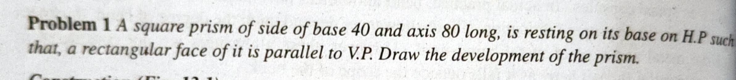
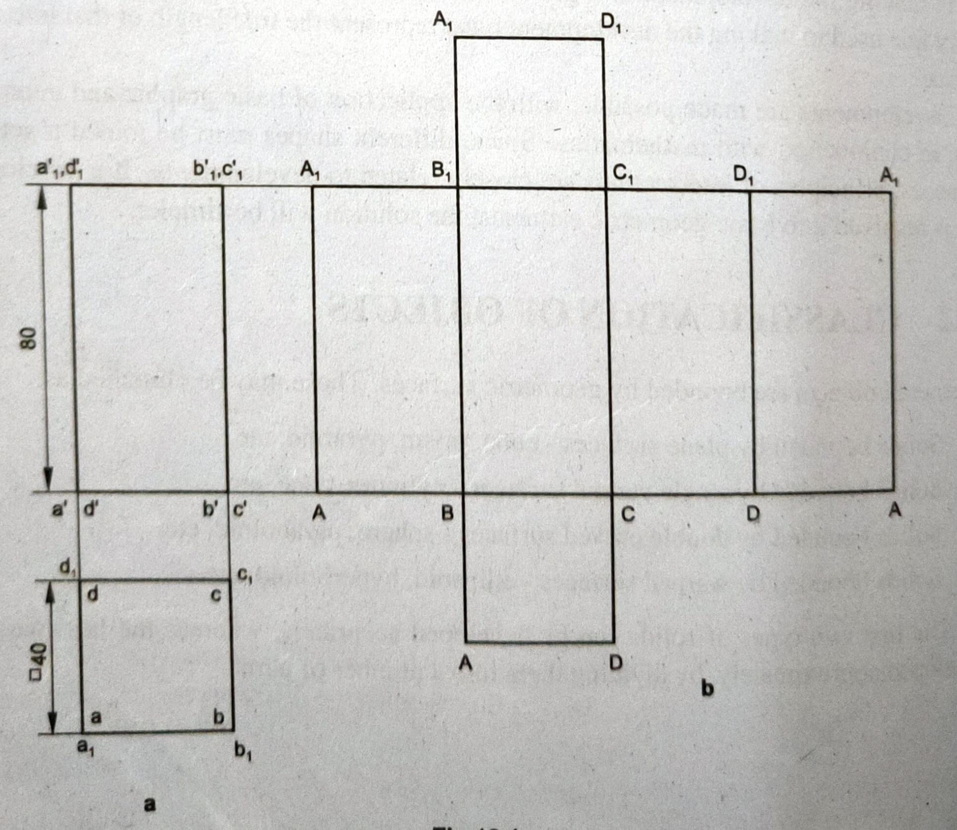

Slide 52
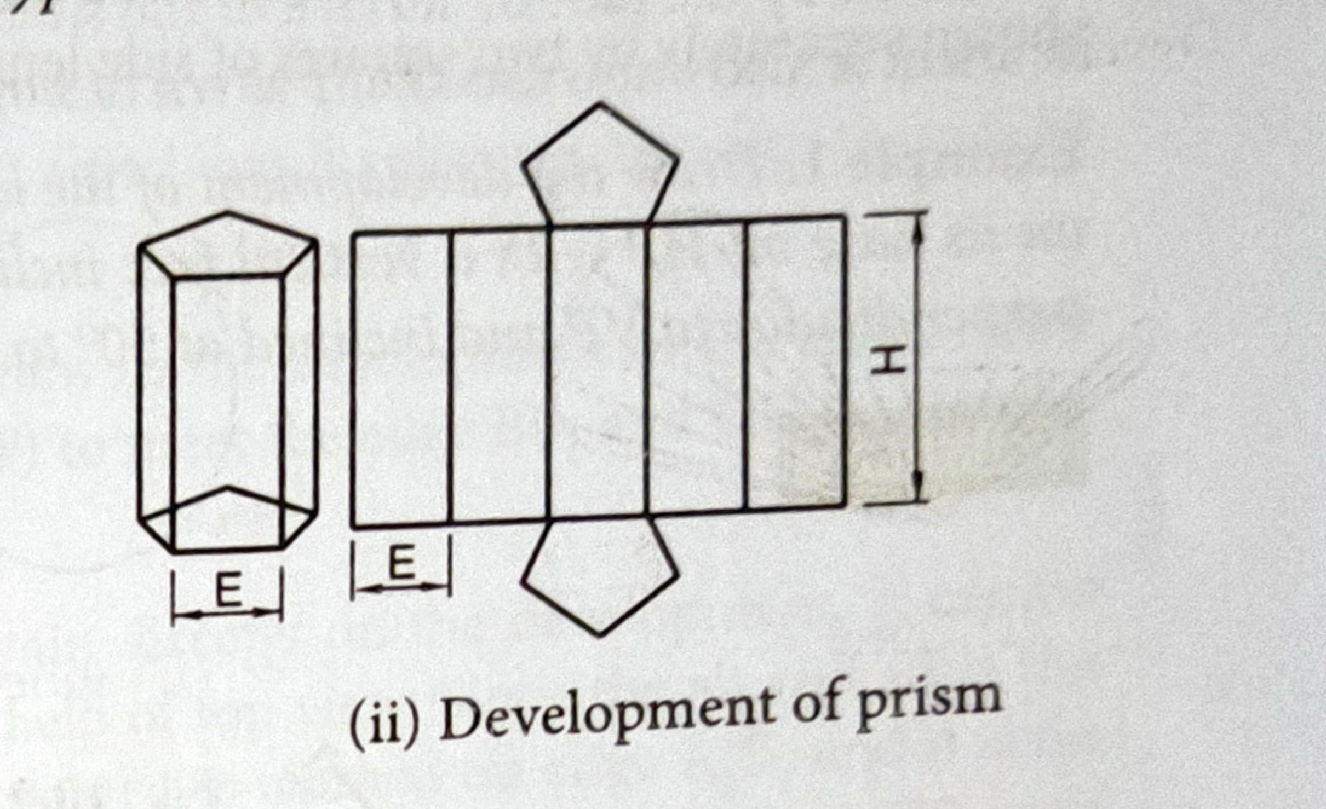

Slide 53
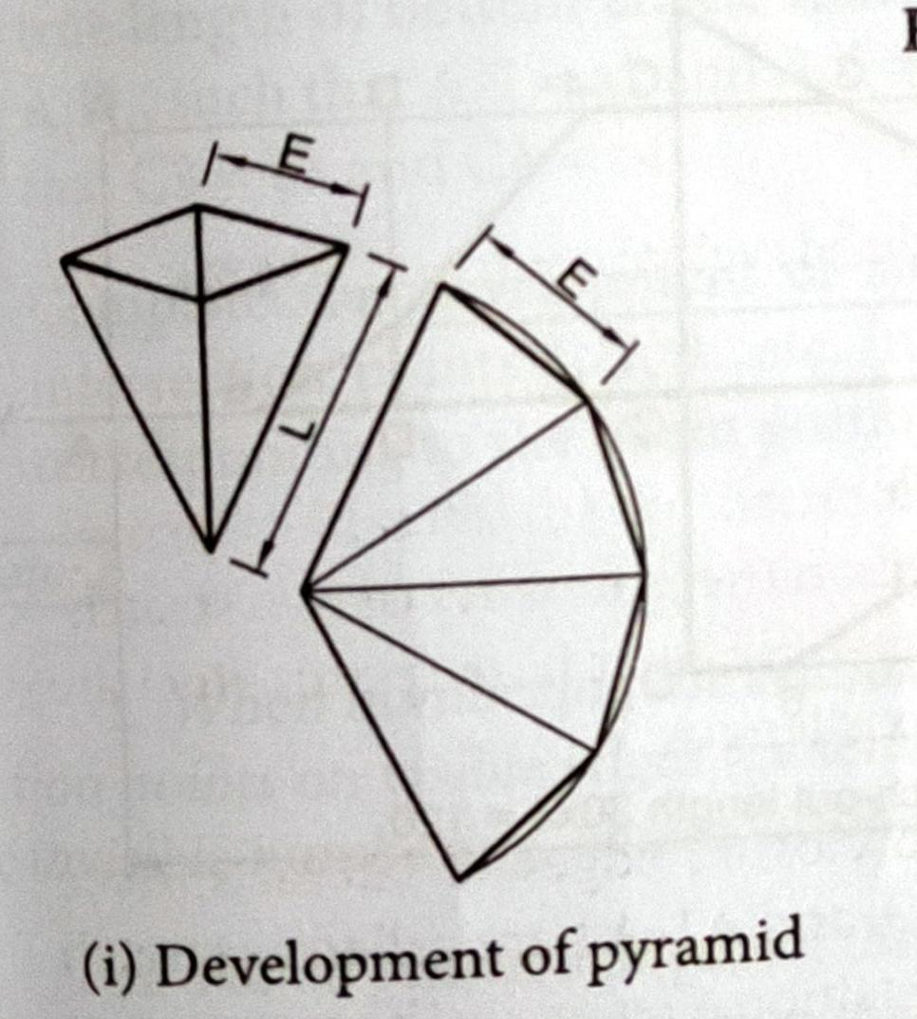

Slide 54
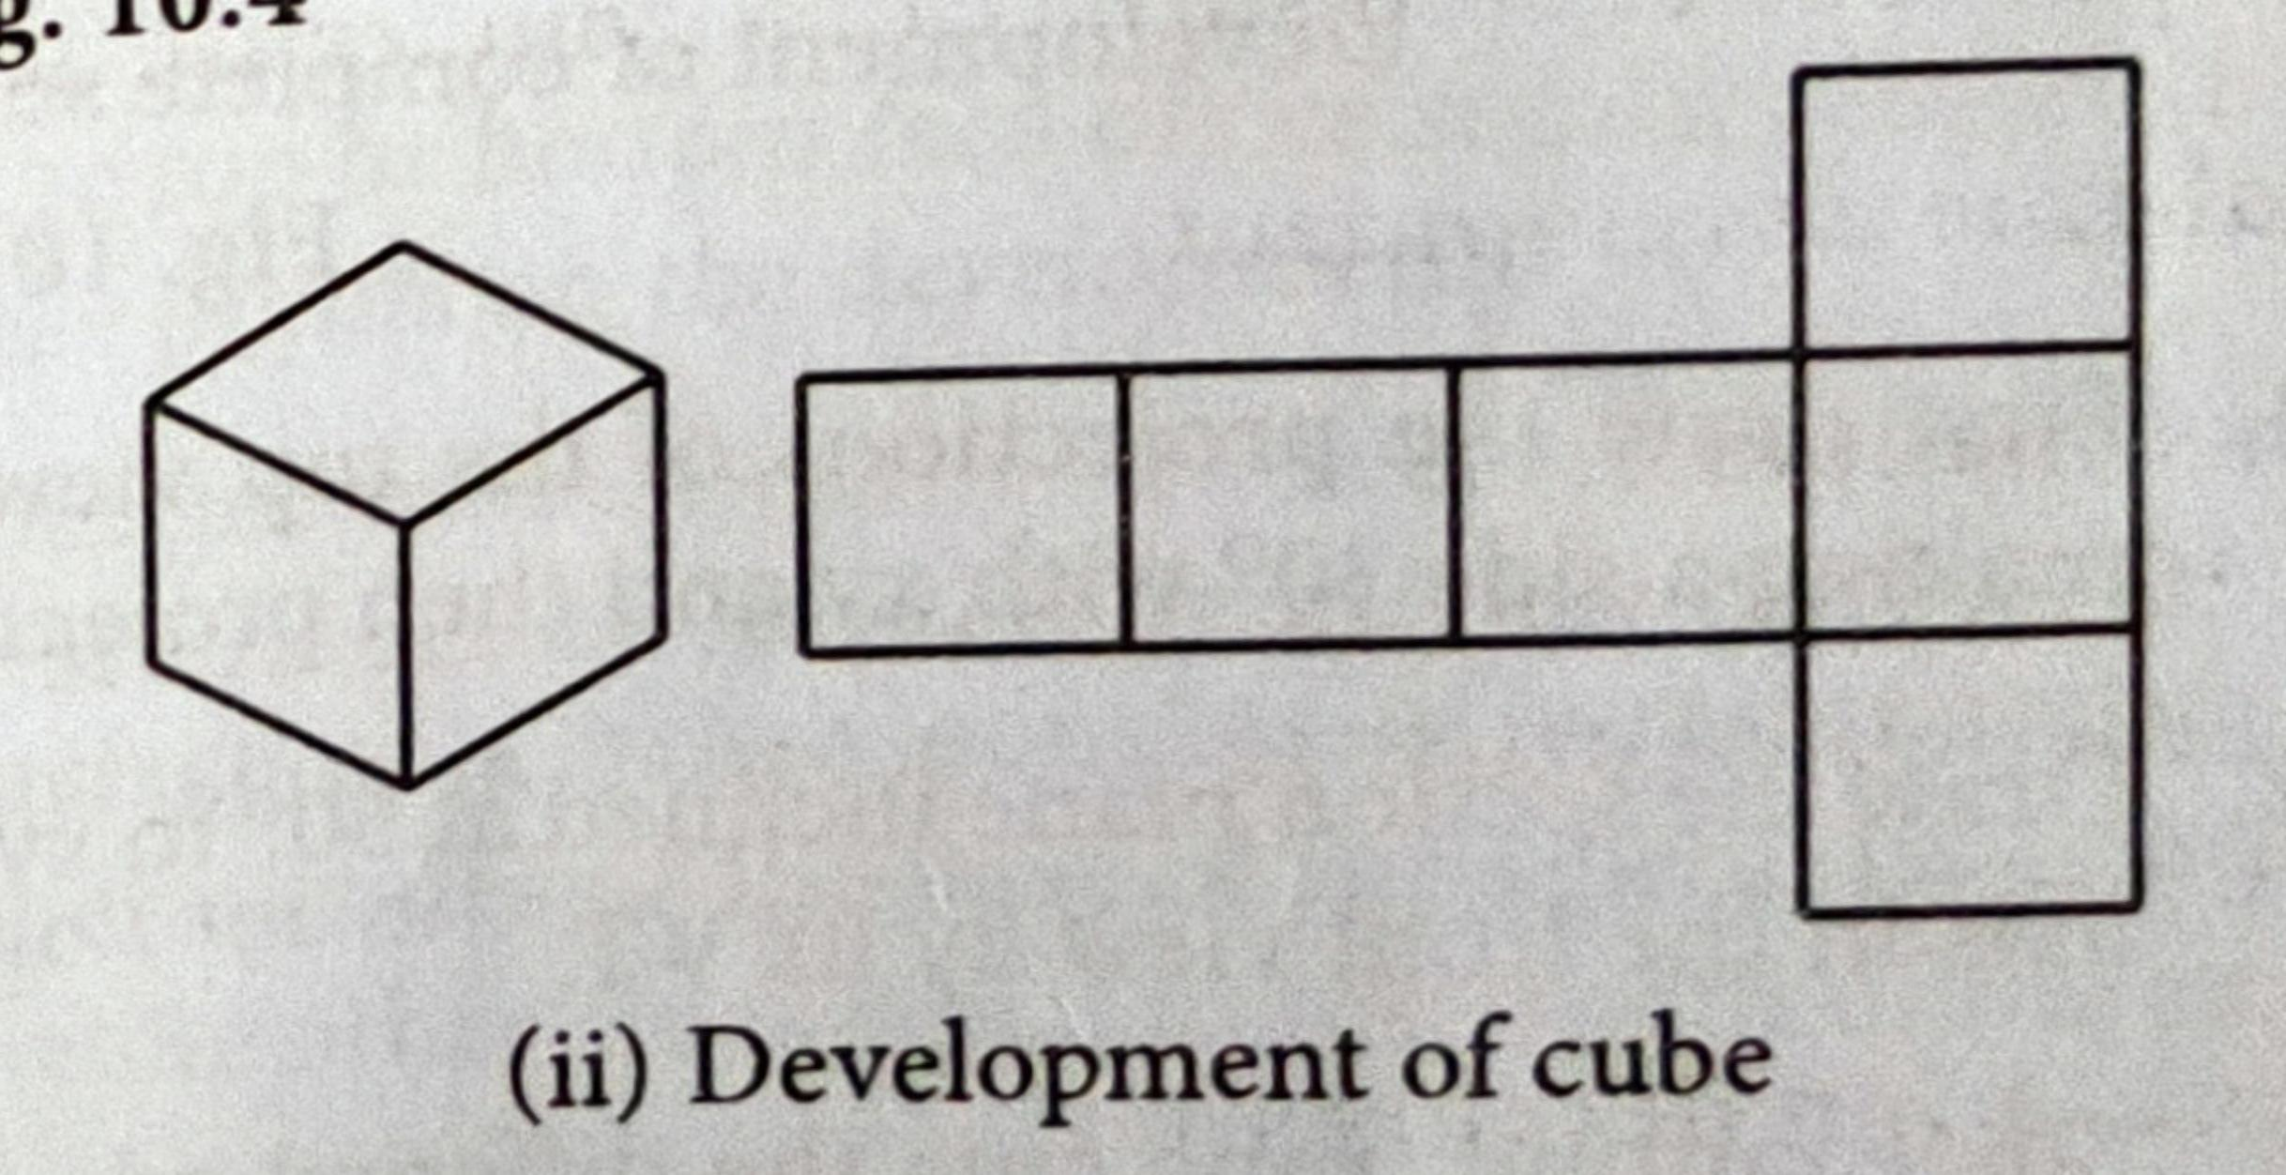

Slide 55
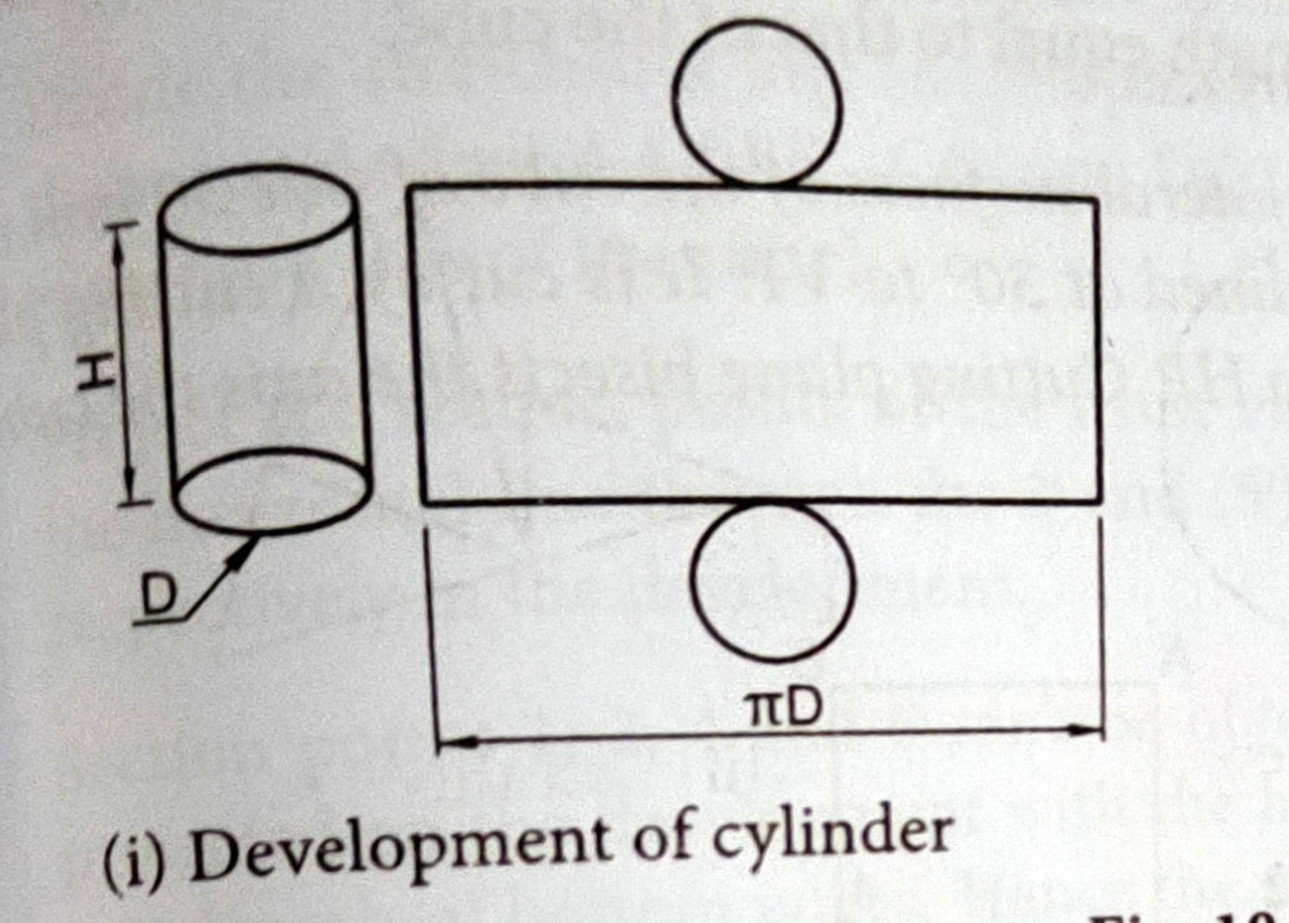

Slide 56
